Slide 1



DermaScope AI An AI-Driven Ecosystem for Autonomous Skin Disease Diagnosis and Proactive Management
24-25J-210

Slide 2




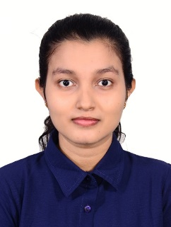


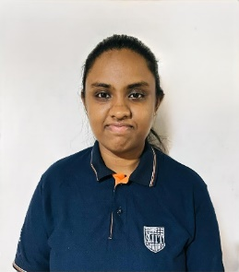
Mr. Samadhi Rathnayake
Supervisor
Gimmana M.R.M IT21176456
Dr. Junius Anjana
Co - Supervisor
Lakshani D.M.W.S
IT21262104
Dr. Saman Gunasekara
External Supervisor
Dr. kasun Nayanakantha
External Supervisor
Perera W.A.S.K
IT21261732
Project ID: 24-25J-210

Slide 3

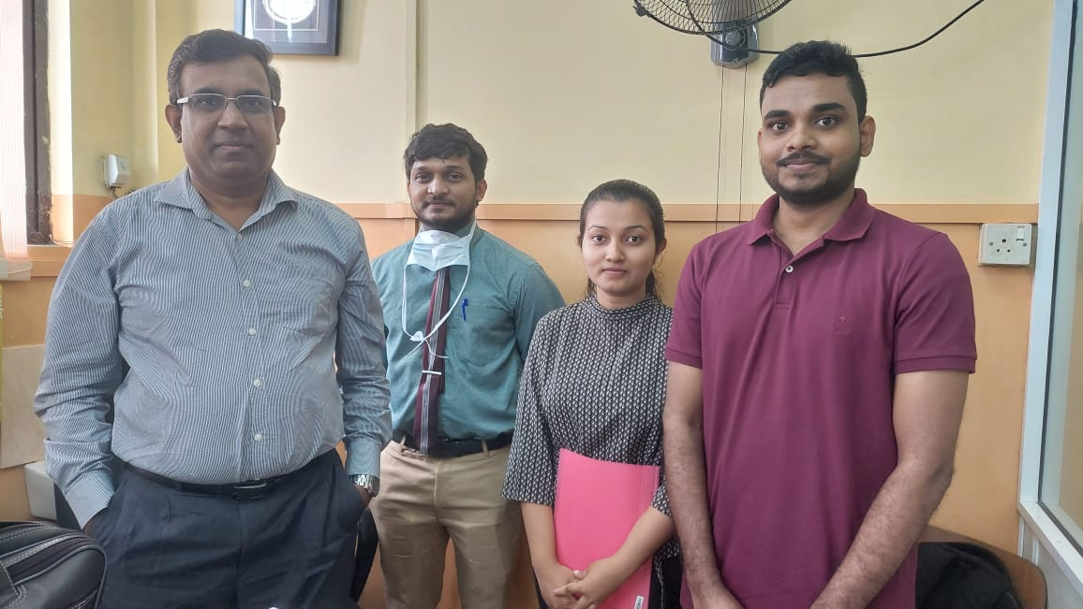
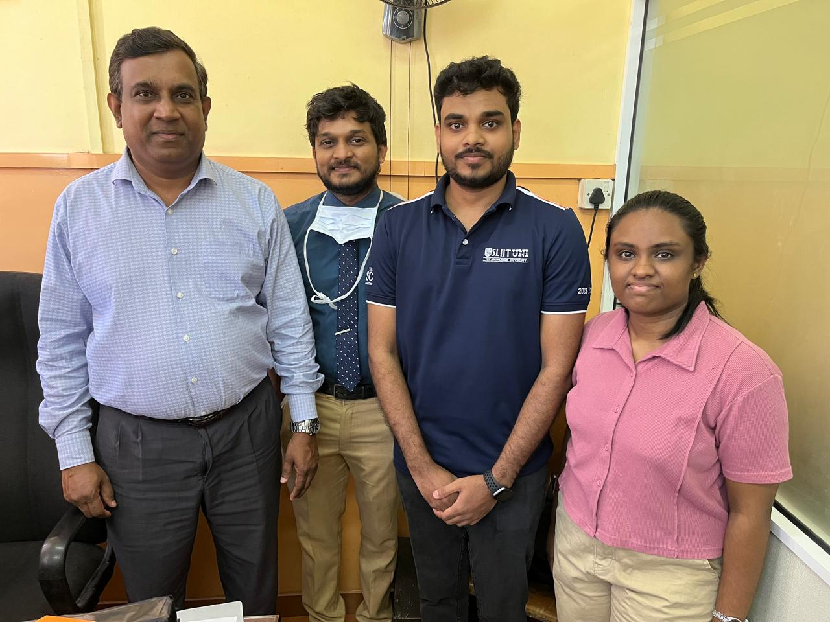
Dr. Saman Gunasekara
External Supervisor
MBBS. MD. (Dermatology)
Consultant Dermatologist
Teaching Hospital - Kalubowila
Dr. kasun Nayanakantha
External Supervisor
Dermatologist
Project ID: 24-25J-210

Slide 4
Introduction
Skin Diseases
Skin diseases are conditions that affect your skin.
They may cause rashes, inflammation, itchiness or other skin changes.
Some skin conditions may be genetic, while lifestyle factors may cause others.
Project ID: 24-25J-210

Slide 5
Research Question
How to leverage machine and deep learning for enhanced dermatological care?
Up to what extent machine and deep learning can be used in Dermatology?
Project ID: 24-25J-210

Slide 6

Answer!
Introduce optimized methods and algorithms to Accurately analyze
skin diseases while align with dermatological theories and laws.
Project ID: 24-25J-210

Slide 7
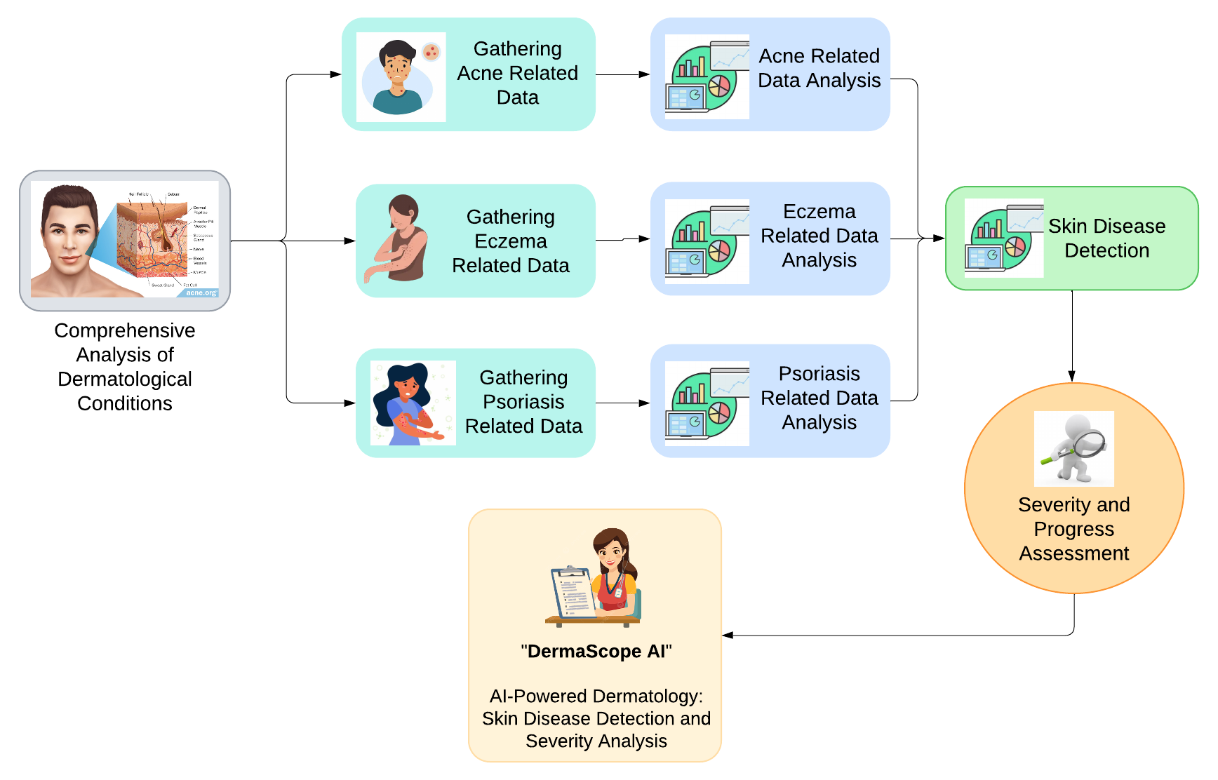
System Diagram

Slide 8

5
Research Objectives
4
Develop a System for Real-Time Monitoring and Management of Skin Diseases Using AI and Machine Learning Techniques.
3
2
1
Project ID: 24-25J-210

Slide 9

5
Research Objectives
4
Enhance Diagnostic Accuracy in Skin Disease Detection and Management Through Advanced Machine Learning Techniques.
3
2
1
Project ID: 24-25J-210

Slide 10
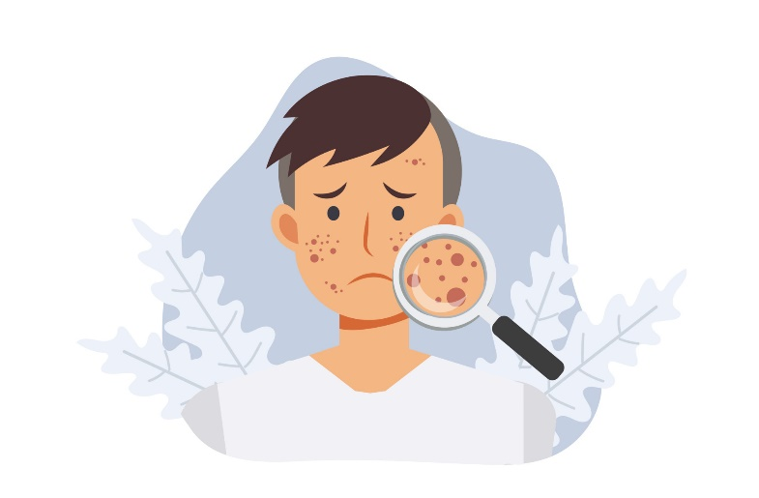
5
Research Objectives
4
Develop a Comprehensive Suite of Machine Learning and AI-Based Models for Acne Assessment and Management.
3
2
1
Project ID: 24-25J-210

Slide 11

Research Objectives
5
4
Develop an Advanced System for Accurate Detection and Severity Assessment of Eczema Using Image Processing Techniques.
3
2
1
Project ID: 24-25J-210

Slide 12
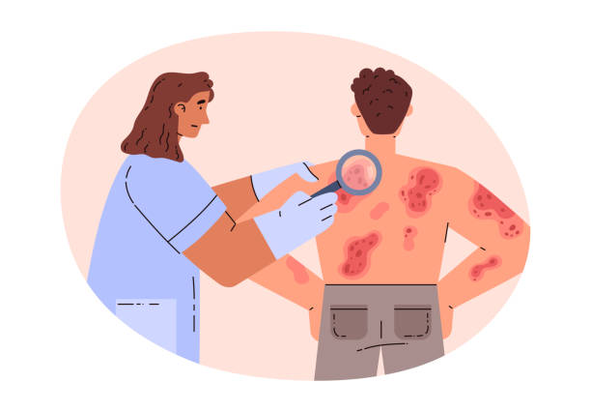
Research Objectives
5
Apply Machine Learning and Computer Vision to Detect Psoriasis and Assess Its Severity from Images.
4
3
2
1
Project ID: 24-25J-210

Slide 13
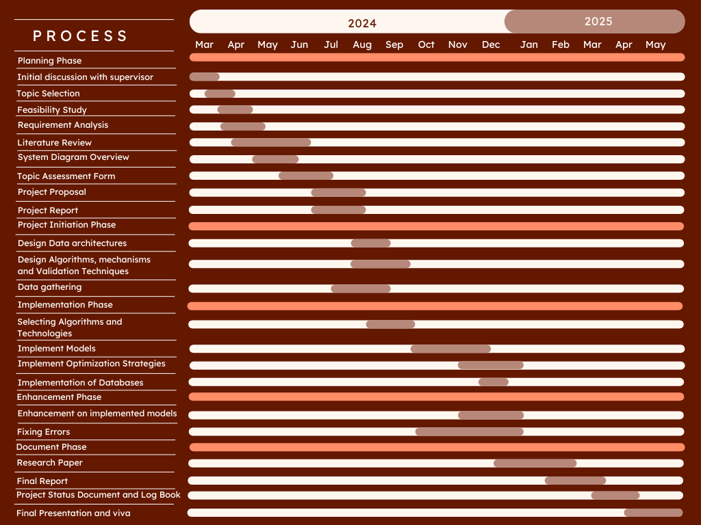
Gannt Chart
Project ID: 24-25J-210

Slide 14

Component 1
Automated Advanced Acne Lesion
Analysis and Monitoring with Artificial Intelligence.
IT21176456 | Gimmana M.R.M
B.Sc (Hons) Degree in Information Technology Specializing in Data Science
IT21176456 | Gimmana M.R.M | 24-25J-210

Slide 15

What is Acne ?
Acne is a common chronic disorder affecting the hair follicle and
sebaceous gland, in which there is expansion and blockage
of the follicle and inflammation.
Who gets Acne?
Acne affects males and females of all races and ethnicities.
It is prevalent in adolescents and young adults,
with 85% of 16- to 18-year-olds affected.
However, it may sometimes occur in children and adults of all ages.
IT21176456 | Gimmana M.R.M | 24-25J-210

Slide 16
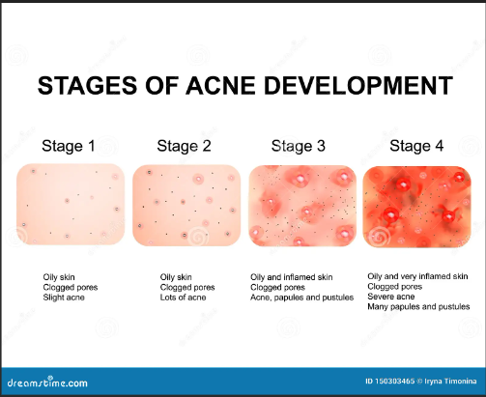
Acne Stages
IT21176456 | Gimmana M.R.M | 24-25J-210

Slide 17

Why we need an AI based Acne detection and monitoring system ?
Detect Acne in early stages.
Correct diagnosis of the current stage of the acne lesion.
Avoid Improper treatments.
Patients can track their healing progress.
Doctors can monitor the patient's healing progress between visits.

Slide 18

What is the importance ?
Early Detection and Diagnosis.
Personalized Healing Progress Monitoring.
Improved Accessibility and Convenience.
Remote Monitoring and Follow-up.
Data-Driven Insights.
IT21176456 | Gimmana M.R.M | 24-25J-210

Slide 19
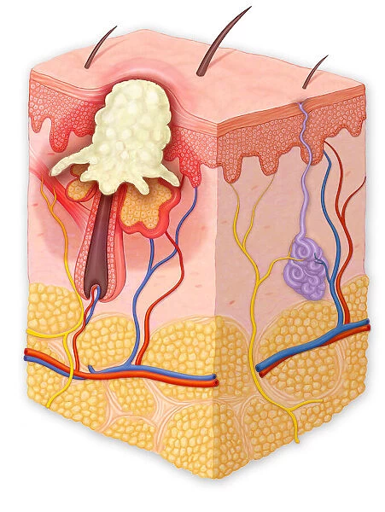
Research problem
How can we develop advanced machine learning techniques be leveraged through image analysis to enhance the precision of acne diagnosis and monitor treatment efficacy?
IT21176456 | Gimmana M.R.M | 24-25J-210

Slide 20
Completed Tasks
Completed Work ~ 100%
Conducted comprehensive acne data collection, preparation, and validation.
Performed thorough data analysis and preprocessing to ensure data quality.
Implemented and enhanced a model for acne detection with improved accuracy.
Developed and optimized a model for acne severity classification.
Siamese neural network was explored as a novel approach to address the challenges of acne image classification.
Designed and implemented a web application for streamlined model deployment and user interaction (patients’ end).
Designed Doctor Dashboard to check the patient’s healing progress.
IT21262104 | Lakshani D.M.W.S | 24-25J-210

Slide 21
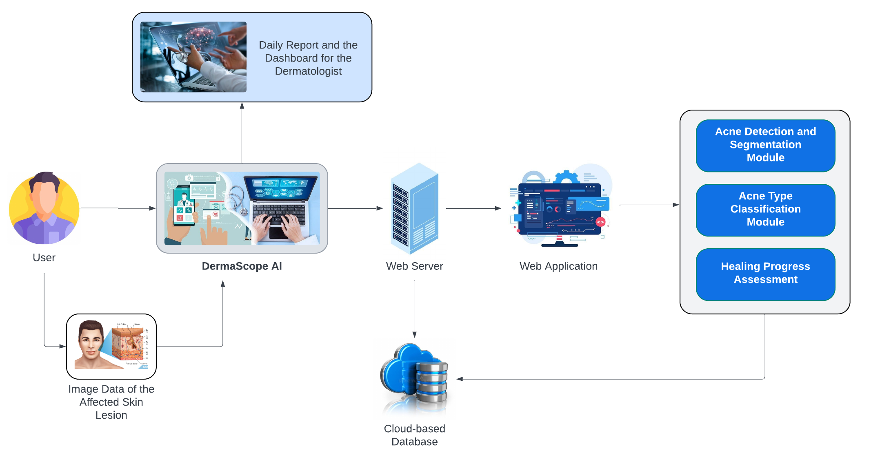
System Diagram
IT21176456 | Gimmana M.R.M | 24-25J-210

Slide 22
Requirements
Personal Requirements
Guidance from the Supervisors on the Eczema and Data Science domain.
Understand the Specific Area of Each Domain to Proceed with the Selected Research Area.
Functional Requirements
Acne Detection Module.
Severity Assessment Module.
Dynamic Segmentation Adjustment.
Non-Functional Requirements
Performance.
Scalability.
Usability.
Security and Privacy.
Reliability.
IT21176456 | Gimmana M.R.M | 24-25J-210

Slide 23
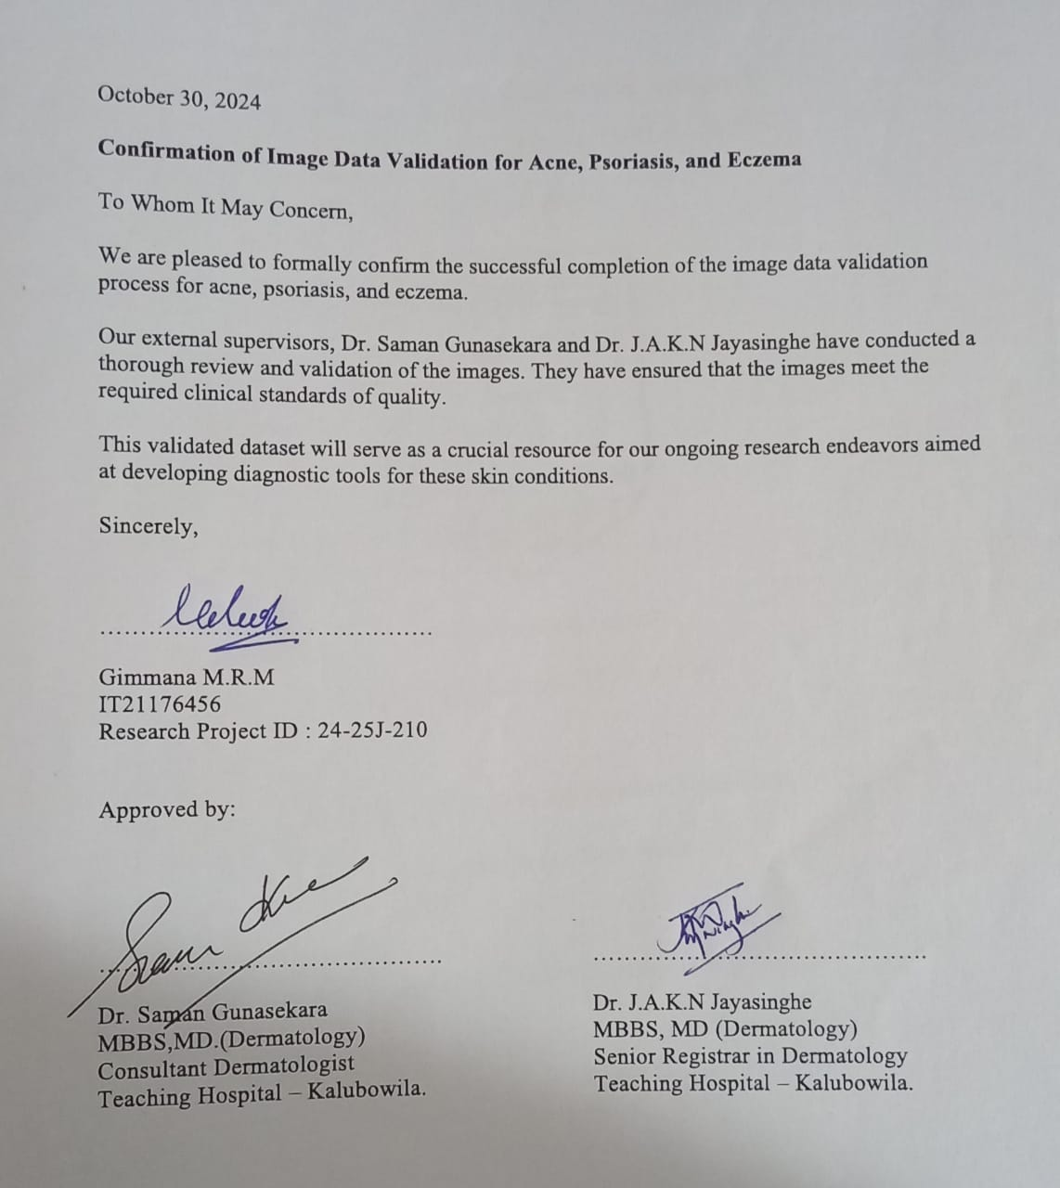


Data Collection & Validation
IT21176456 | Gimmana M.R.M | 24-25J-210

Slide 24
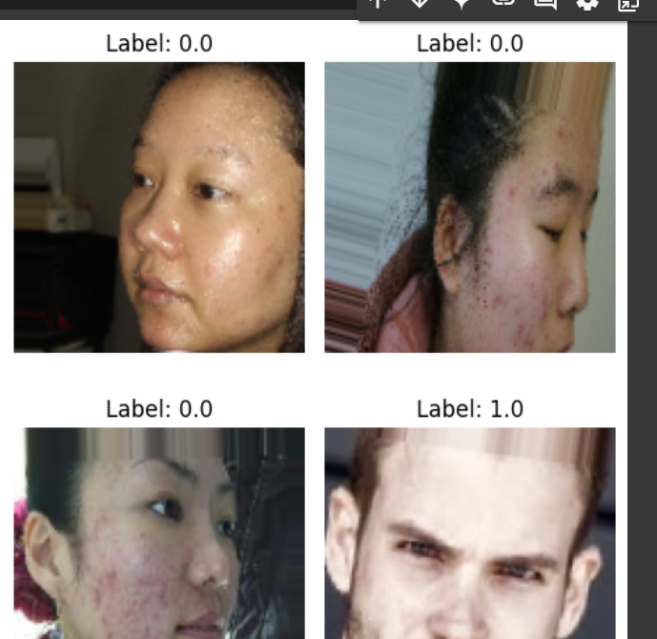
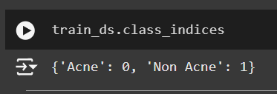
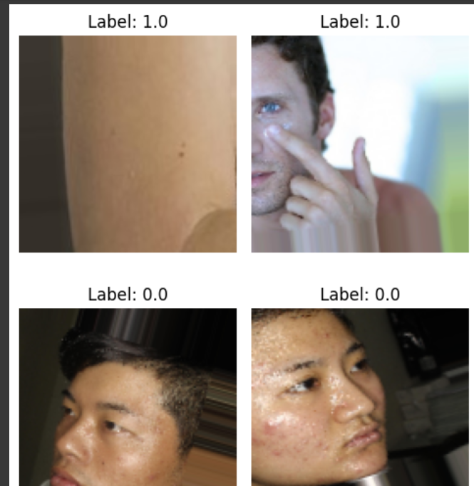
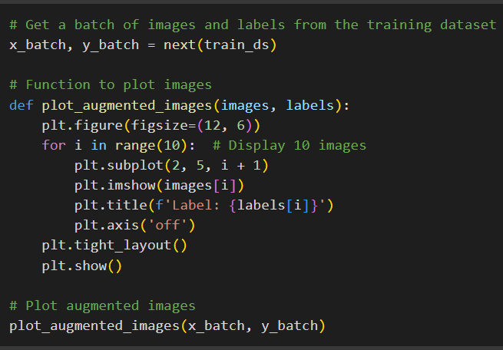
Data Exploration
Acne Dataset
IT21176456 | Gimmana M.R.M | 24-25J-210

Slide 25
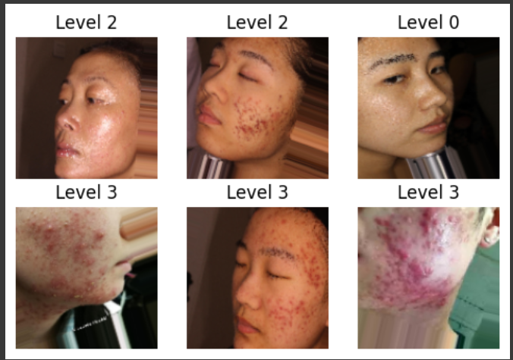
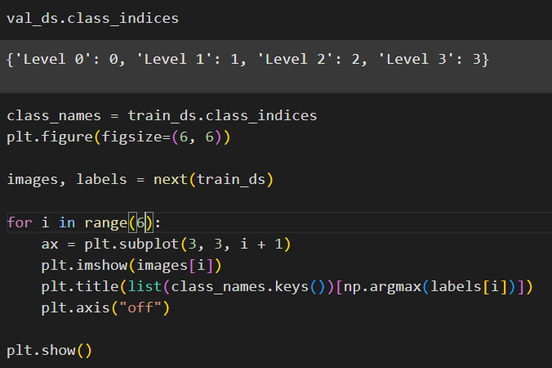
Data Exploration
Acne Severity Dataset
IT21176456 | Gimmana M.R.M | 24-25J-210

Slide 26
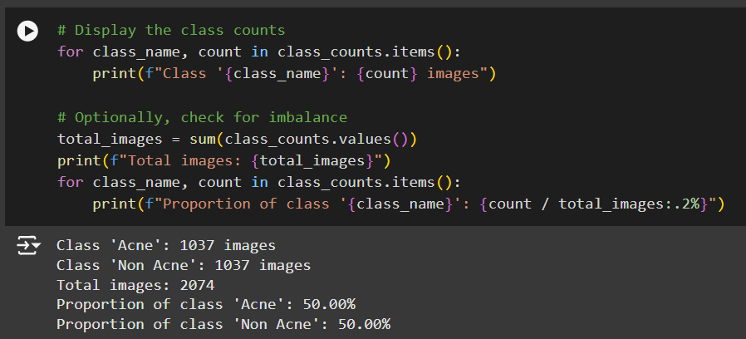
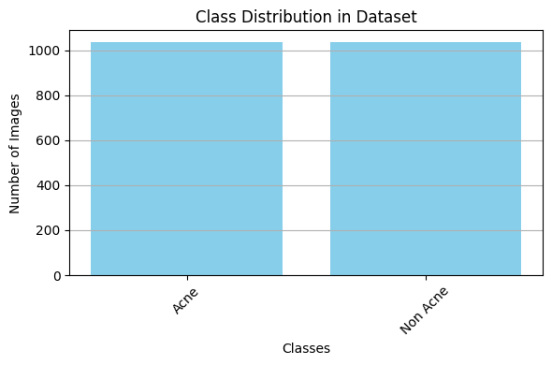
Exploratory Data Analysis
Acne / Non-Acne Dataset
IT21176456 | Gimmana M.R.M | 24-25J-210

Slide 27
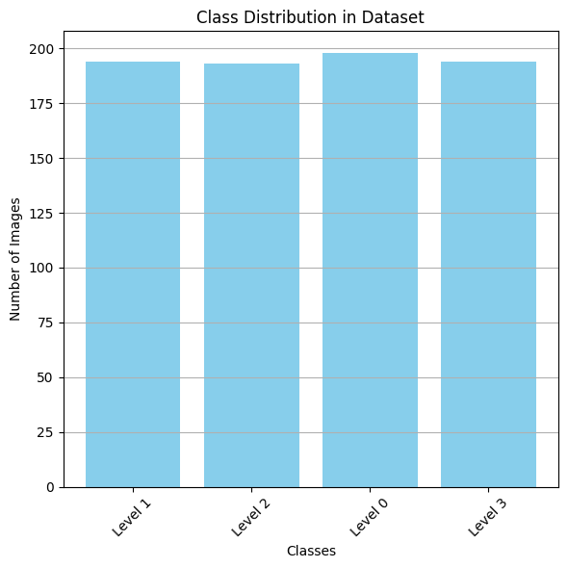
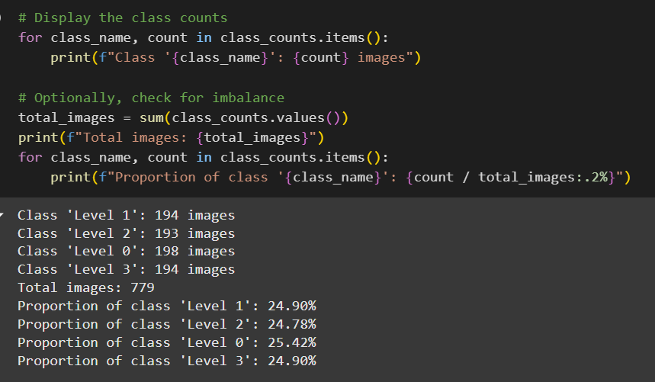
Exploratory Data Analysis
Acne Severity Dataset
IT21176456 | Gimmana M.R.M | 24-25J-210

Slide 28
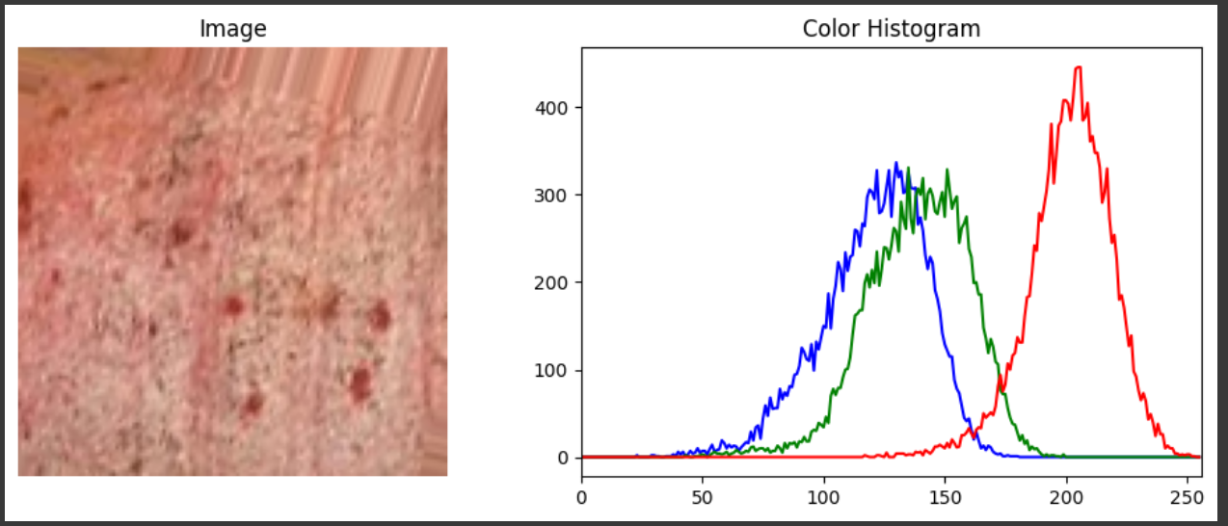
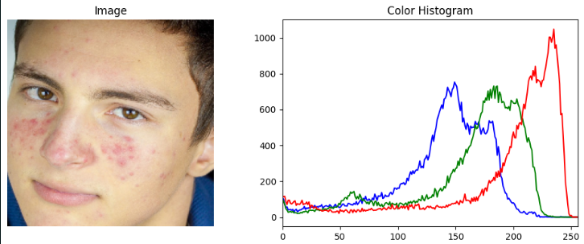
Exploratory Data Analysis
Color Histogram
Acne often presents with specific color characteristics, such as redness, inflammation, or variations in skin tone. By analyzing the color distribution of images in our dataset, we can gain insights into these characteristics and how they might differentiate acne from non-acne images.
IT21176456 | Gimmana M.R.M | 24-25J-210

Slide 29
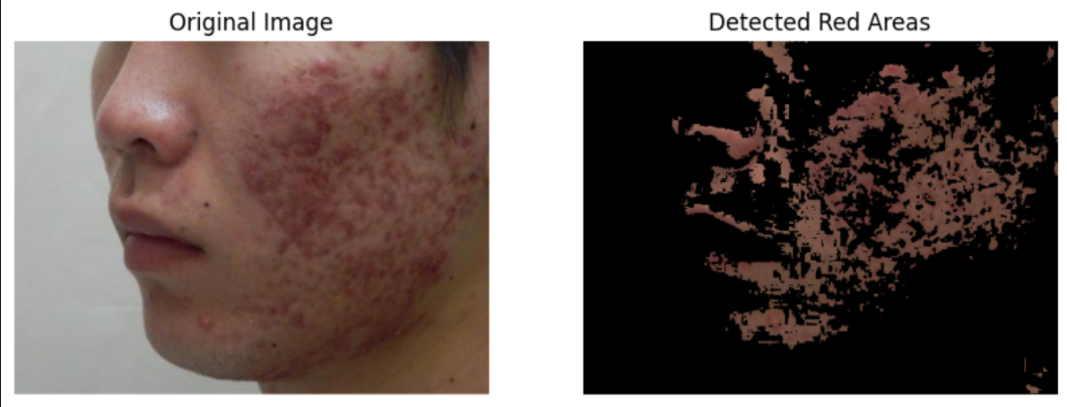
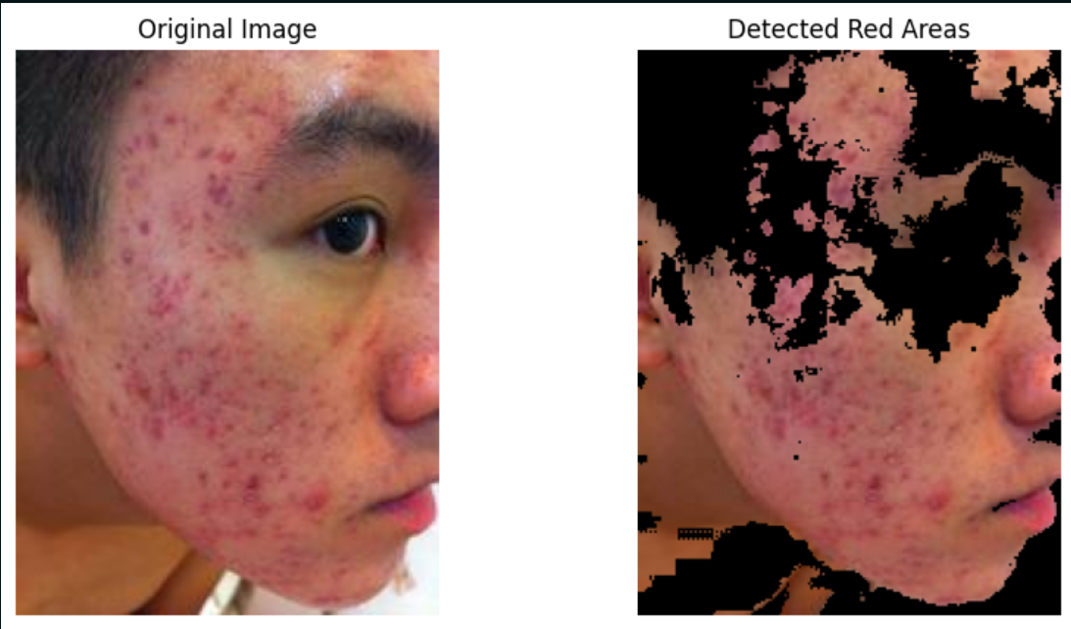
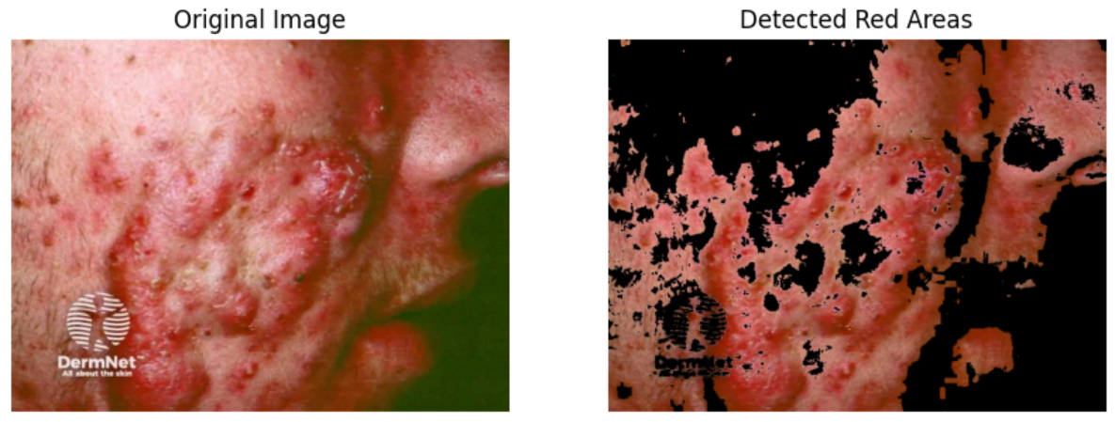
Acne Lesion Localization
IT21176456 | Gimmana M.R.M | 24-25J-210

Slide 30
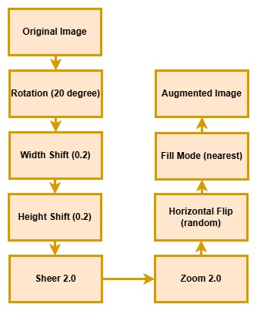
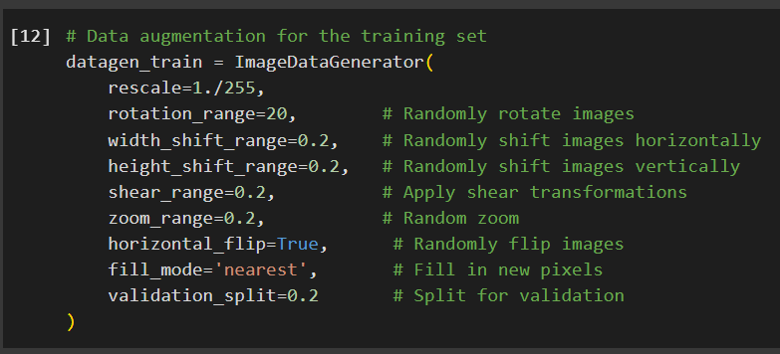
Data Augmentation
Data Augmentation using ImageDataGenerator
IT21176456 | Gimmana M.R.M | 24-25J-210

Slide 31
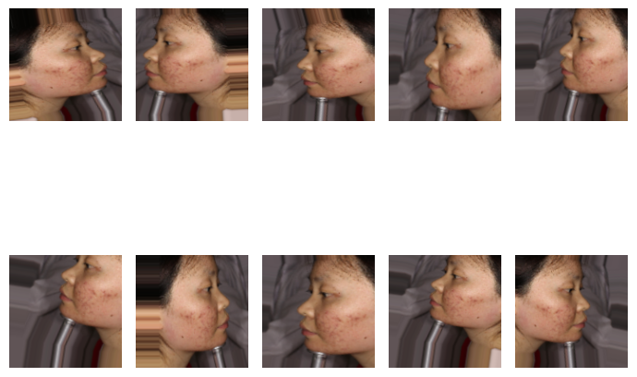
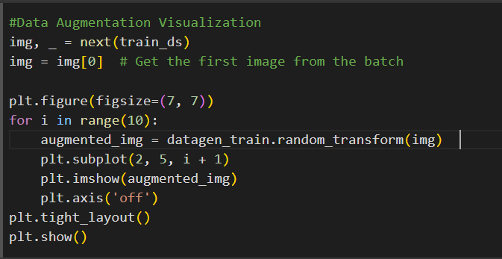
Data Augmentation
Data Augmentation Visualization
IT21176456 | Gimmana M.R.M | 24-25J-210

Slide 32
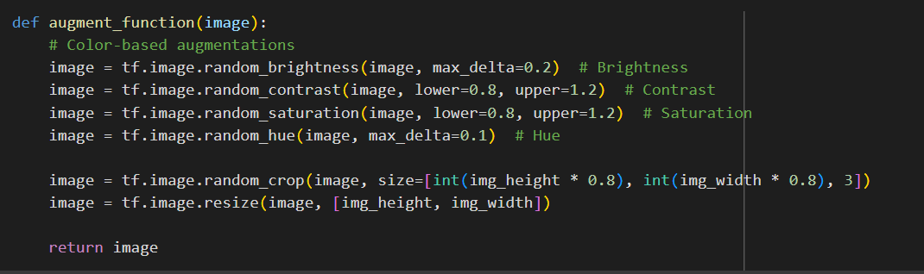
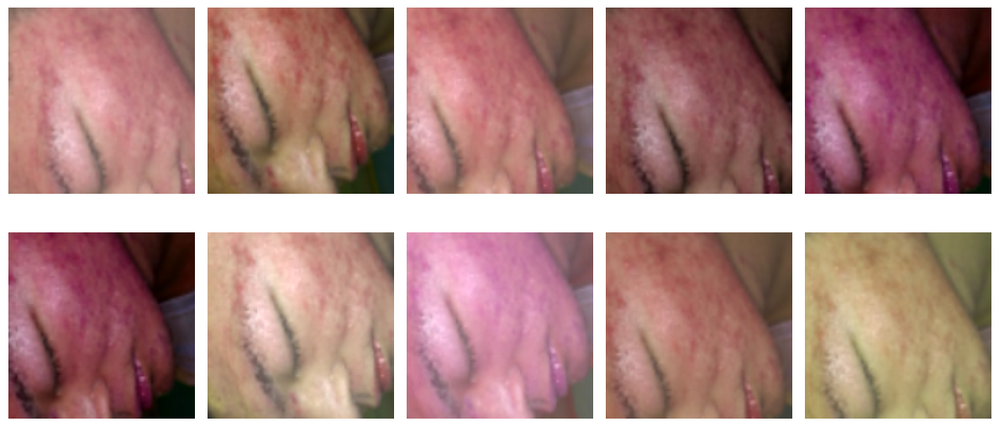
Data Augmentation
Color Based Augmentation Visualization
IT21176456 | Gimmana M.R.M | 24-25J-210

Slide 33
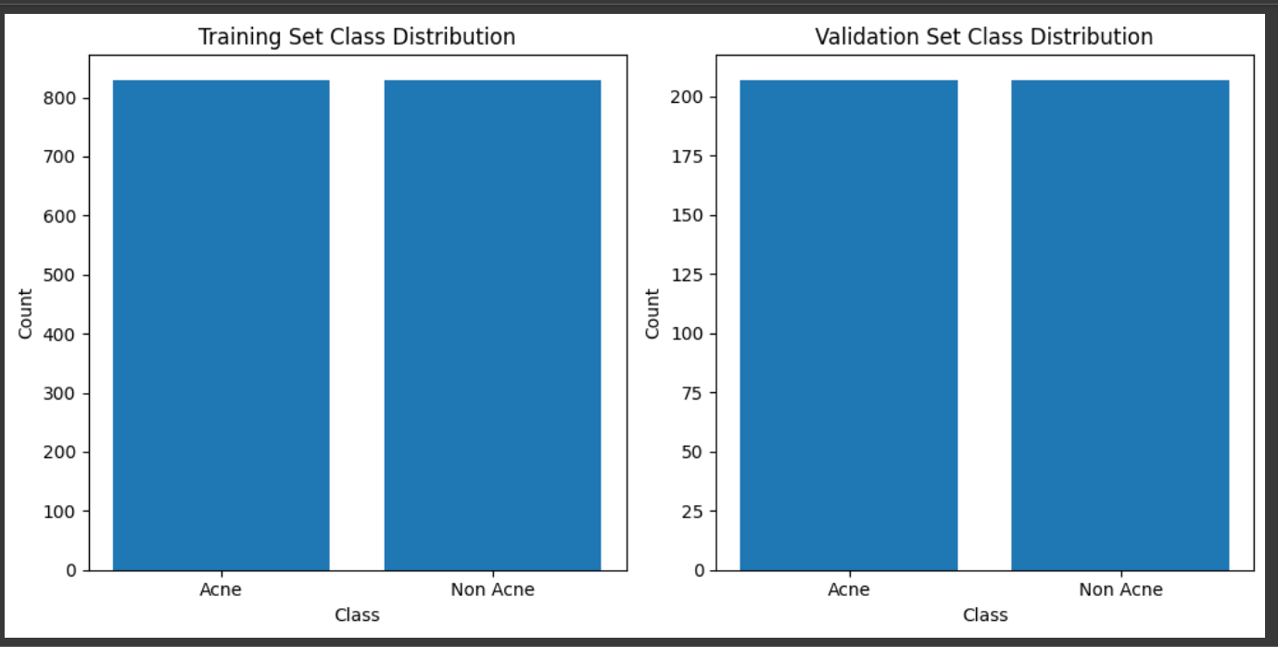
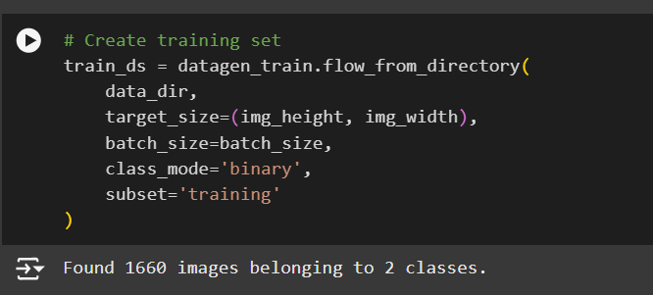
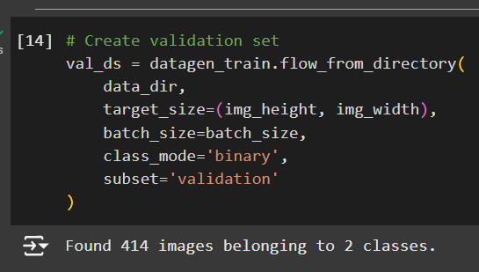
Data Preprocessing
Splitting Dataset Into Training and Validation
IT21176456 | Gimmana M.R.M | 24-25J-210

Slide 34

Previous Research Comparison
Research [1]
CNN was used for Acne classification tasks and achieved an accuracy of 68%
Research [2]
VGG16 with PLSBRACNE01 dataset was used for classification tasks and achieved an accuracy of 60%
Research [3]
Acne lesions was classified with 80% accuracy using fuzzy-c-means
Research [4]
Used Weightless Inception Model for acne subtype and severity detection and gain validation accuracy of 54%
Research [5]
Used k-means clustering, HSV model segmentation techniques, two level k-means clustering used and achieved an accuracy of about 70%
DermaScope AI
A CNN model with Acne localization and red-lesion enhancement achieved 93% accuracy for acne detection and achieved 74% for acne severity detection .
IT21262104 | Lakshani D.M.W.S | 24-25J-210

Slide 35
Training Models for Acne Detection
Deep Learning Model | Accuracy
CNN | 93.73%
VGG16 | 99.28%
VGG19 | 98.07%
ViT | 80.47%
Siamese | 91.30%
ResNet | 95.18%
IT21176456 | Gimmana M.R.M | 24-25J-210

Slide 36
Model Implementation for Acne Detection
Best Model :- CNN
CNNs utilize convolutional layers that can learn hierarchical features from images. Lower layers detect basic features like edges and corners, while deeper layers combine these to identify more complex patterns specific to acne, such as the shape, size, and texture of pimples..
CNNs employ pooling layers, which provide a degree of translation invariance, meaning the network can recognize acne regardless of its location in the image. Convolutional layers themselves exhibit translation equivariance, meaning if the input shifts, the feature map shifts by the same amount.
With sufficient training data, CNNs can become robust to variations in lighting conditions, image quality, camera angles, and individual skin tones.
CNN architectures offer a wide range of hyperparameters and design choices that can be tailored to the specific characteristics of the acne detection task and the available dataset.
CNN
Ability to Learn Spatial Hierarchies
Translation Invariance and Equivariance
Customizability
Robustness to Variations
IT21176456 | Gimmana M.R.M | 24-25J-210

Slide 37
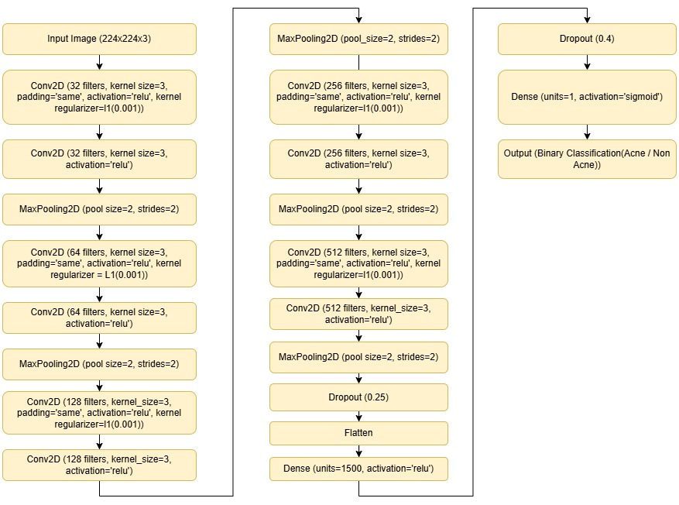
Model Implementation for Acne Detection
Best Model :- CNN
IT21176456 | Gimmana M.R.M | 24-25J-210

Slide 38
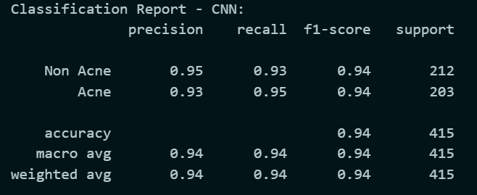
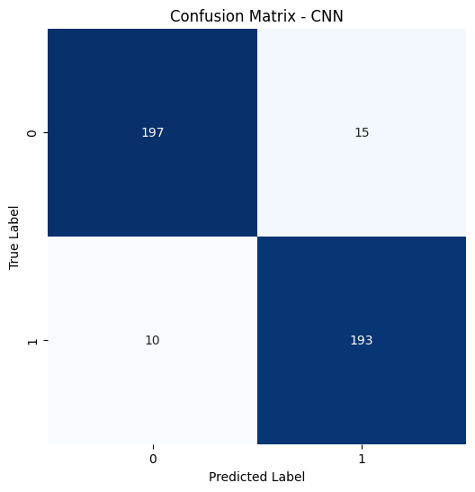
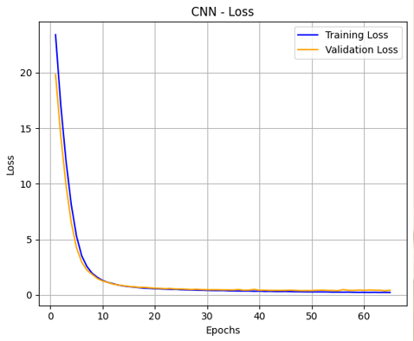
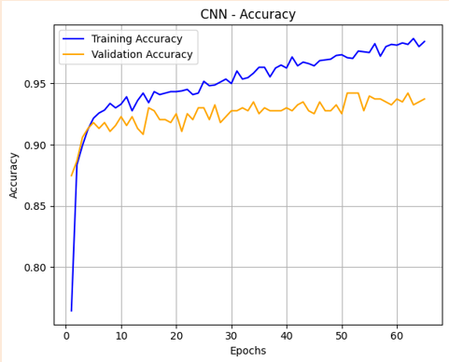
Model Implementation for Acne Detection
Best Model :- CNN
IT21176456 | Gimmana M.R.M | 24-25J-210

Slide 39
Model Implementation for Acne Detection
Siamese
Siamese
Learning Robust Feature Embeddings
Effective with Limited Data
Flexibility in Defining Similarity
Novelty Detection
Handling
Siamese networks are well-suited for scenarios where the number of labeled acne images is limited. They learn a similarity metric rather than directly classifying.
Siamese networks learn to map input images into a lower-dimensional embedding space where images of the same class are closer together, and images of different classes are further apart.
Once a Siamese network is trained to distinguish between known acne and non-acne, it can potentially be used to identify images that are significantly different from both categories.
The distance metric used to compare the embeddings in a Siamese network can be chosen and potentially learned or tuned.
IT21176456 | Gimmana M.R.M | 24-25J-210

Slide 40
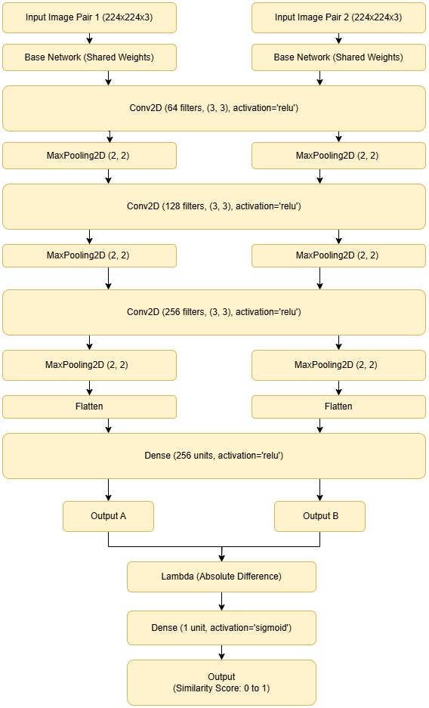
Model Implementation for Acne Detection
Siamese
IT21176456 | Gimmana M.R.M | 24-25J-210

Slide 41
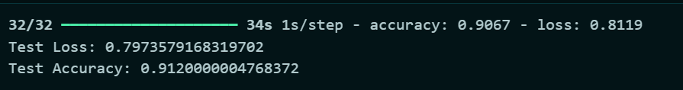
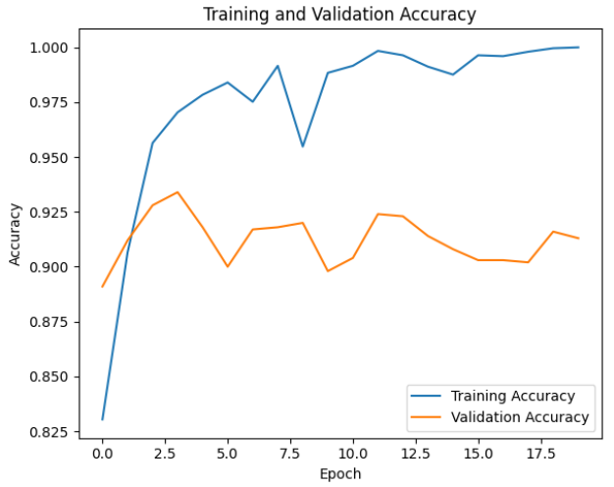
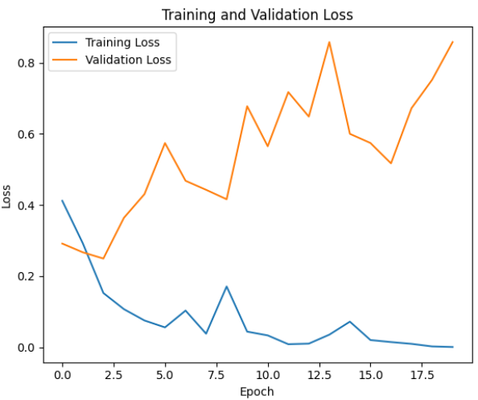
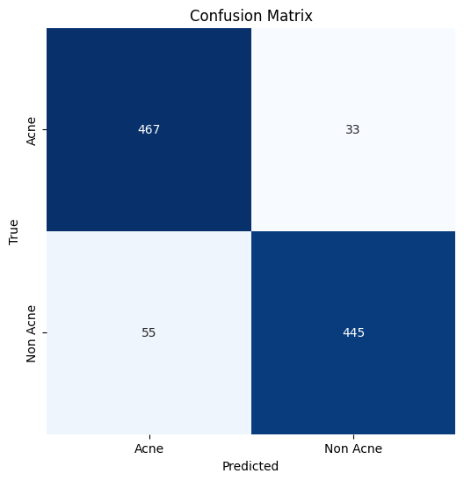
Model Implementation for Acne Detection
Siamese
IT21176456 | Gimmana M.R.M | 24-25J-210

Slide 42

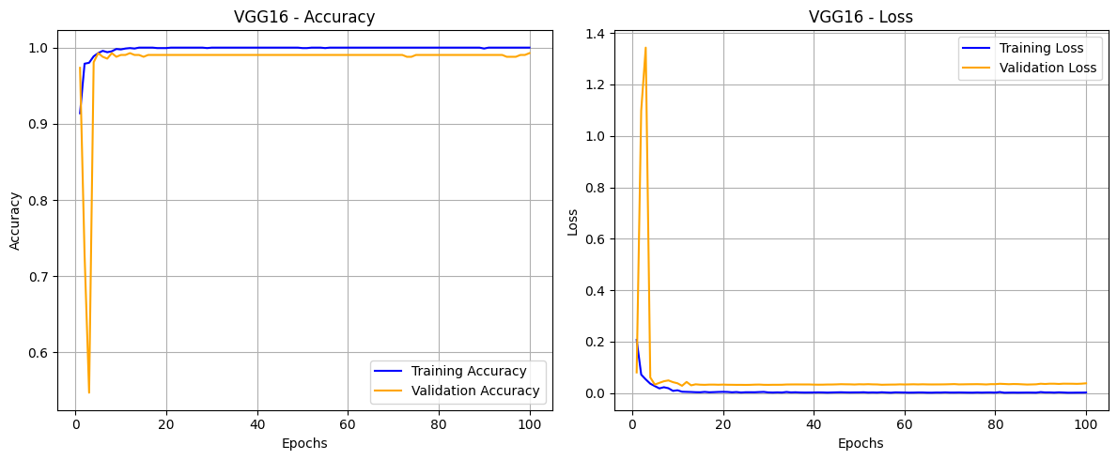
Model Implementation for Acne Detection
VGG 16
IT21176456 | Gimmana M.R.M | 24-25J-210

Slide 43

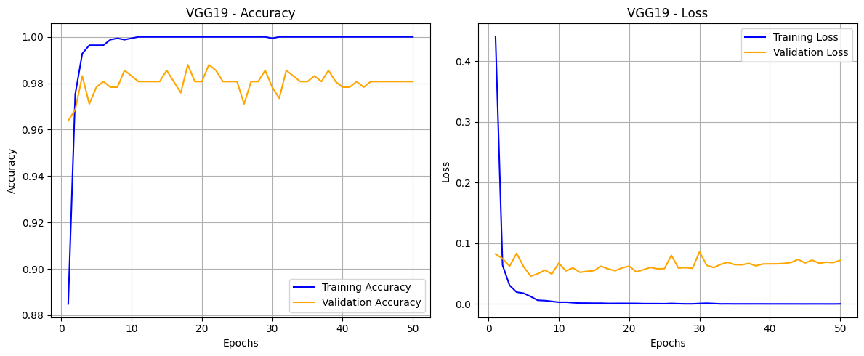
Model Implementation for Acne Detection
VGG 19
IT21176456 | Gimmana M.R.M | 24-25J-210

Slide 44

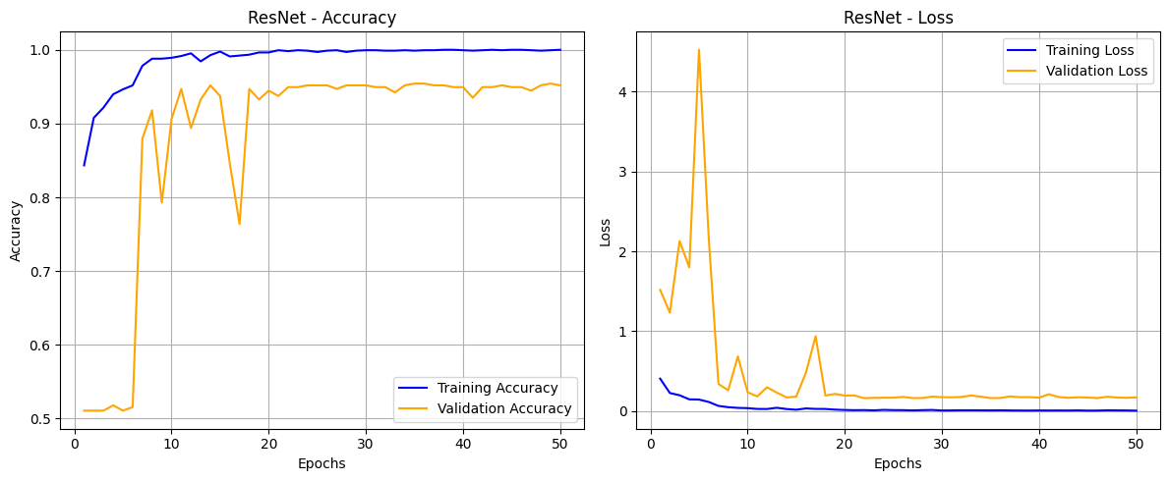
Model Implementation for Acne Detection
ResNet
IT21176456 | Gimmana M.R.M | 24-25J-210

Slide 45
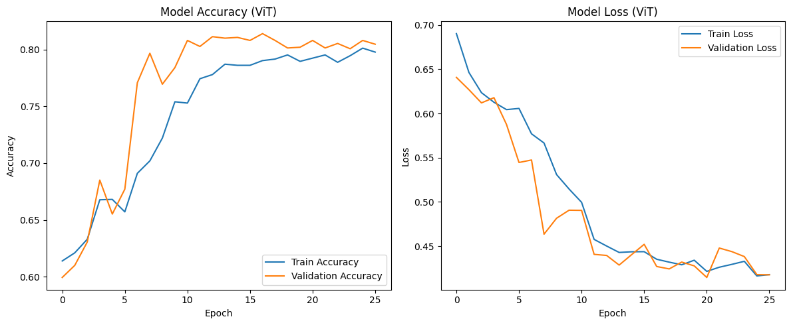
Model Implementation for Acne Detection
ViT
IT21176456 | Gimmana M.R.M | 24-25J-210

Slide 46


Model Implementation for Acne Detection
EfficientNetB0
IT21176456 | Gimmana M.R.M | 24-25J-210

Slide 47
Training Models for Acne Severity Detection
Deep Learning Model | Accuracy
ViT | 60.99%
CNN | 74.21%
VGG16 | 73.39%
ResNet50V2 | 64.10%
Siamese + CNN | 40.00%
IT21176456 | Gimmana M.R.M | 24-25J-210

Slide 48
Model Implementation for Acne Severity Detection
Best Model :- CNN
CNN
Automatic Feature Learning, Reducing Reliance on Manual Grading Criteria
Ability to Learn Hierarchical and Granular Features
Robustness to Variations within Severity Levels
Spatial Feature Extraction for Severity Indicators
CNNs can learn a hierarchy of features, starting from basic edges and textures to more complex patterns that correspond to different stages and characteristics of acne severity.
Acne severity isn't just about the presence of lesions but also their spatial distribution, density, and co-occurrence. CNNs excel at capturing these spatial relationships.
Even within a specific severity level (e.g., moderate), there can be variations in appearance across individuals. CNNs, when trained on a diverse dataset, can become robust to these intra-class variations
Traditional acne grading often relies on manual counting and classification of lesions based on specific criteria. CNNs can learn these underlying criteria directly from the images, potentially leading to more objective and consistent assessments.
IT21176456 | Gimmana M.R.M | 24-25J-210

Slide 49

Model Implementation for Acne Severity Detection
Best Model :- CNN
IT21176456 | Gimmana M.R.M | 24-25J-210

Slide 50



Model Implementation for Acne Severity Detection
Best Model :- CNN
IT21176456 | Gimmana M.R.M | 24-25J-210

Slide 51
Model Implementation for Acne Severity Detection
Siamese with CNN
Siamese with CNN
Enhanced Feature Representation
Customizability
Better Handling of Intra-Class Variability
Focus on Severity-Specific Features accuracy
Siamese Network Training: Train a Siamese network on pairs of acne images, where the labels indicate whether the pair belongs to the same severity level or different levels. The output of this network is a feature embedding for each input image.
Feature Extraction: Use the trained Siamese network to extract feature embeddings for all the images in your acne severity dataset.
CNN Classifier Training: Train a standard CNN classifier using these extracted feature embeddings as input and the acne severity levels as the target labels. This CNN learns to map the feature embeddings to the correct severity class.
IT21176456 | Gimmana M.R.M | 24-25J-210

Slide 52


Model Implementation for Acne Severity Detection
Siamese with CNN
IT21176456 | Gimmana M.R.M | 24-25J-210

Slide 53

Model Implementation for Acne Severity Detection
ViT
IT21176456 | Gimmana M.R.M | 24-25J-210

Slide 54

Model Implementation for Acne Severity Detection
EfficientNetB0
IT21176456 | Gimmana M.R.M | 24-25J-210

Slide 55


Model Implementation for Acne Severity Detection
VGG 16
IT21176456 | Gimmana M.R.M | 24-25J-210

Slide 56
Model Implementation for Acne Severity Detection
ResNet50V2
IT21176456 | Gimmana M.R.M | 24-25J-210

Slide 57



Web Application Development
IT21176456 | Gimmana M.R.M | 24-25J-210

Slide 58
Future Works
Doctor’s dashboard implementation
Documentations
IT21176456 | Gimmana M.R.M | 24-25J-210

Slide 59
Reference
[1] Gerges, F., Shih, F., Azar, D. (2021, September). Automated diagnosis of acne and rosacea using convolution neural networks. In Proceedings of the 2021 4th International Conference on Artificial Intelligence and Pattern Recognition (pp. 607-613).
[2] Yi Lin , Jingchi Jiang , Dongxin Chen , Zhaoyang Ma , Yi Guan . “Acne Severity Grading on Face Images via Extraction and Guidance of Prior Knowledge”. 2022 IEEE International Conference on Bioinformatics and Biomedicine (BIBM) | 978-1-6654-6819-0/22/$31.00 ©2022 IEEE | DOI: 10.1109/BIBM55620.2022.9995101
[3] N. Alamdari, K. Tavakolian, M. Alhashim, and R. Fazel-Rezai, “De tection and classification of acne lesions in acne patients: A mobile application,” in Electro Information Technology (EIT), 2016 IEEE In ternational Conference on. IEEE, 2016, pp. 0739–0743.
[4] Krithika Naidu , Omkar Kareppa , Sridhar Menon , Chitra Bhole , Dr.Shital Poojary . “Dermato: A Deep Learning based Application for Acne Subtype and Severity Detection “ . International Conference on Innovative Data Communication Technologies and Application (ICIDCA-2023) IEEE Xplore Part Number: CFP23CR5-ART; ISBN: 979-8-3503-9720-8
[5] Nasim Alamdari , Kouhyar Tavakolian , Reza Fazel-Rezai . “Detection and Classification of Acne Lesions in Acne Patients: A Mobile Application “. 978-1-4673-9985-2/16/$31.00 ©2016 IEEE.
IT21176456 | Gimmana M.R.M | 24-25J-210

Slide 60

Component 2
Utilizing Advanced Machine Learning Technologies For Detailed Eczema Diagnosis And Assessment
IT21262104 | Lakshani D.M.W.S
B.Sc (Hons) Degree in Information Technology Specializing in Data Science
IT21262104 | Lakshani D.M.W.S | 24-25J-210

Slide 61
Background
What is Eczema?
What are the current challenges and need for an advanced solution?
How Advanced Machine Learning Techniques Can Improve the Assessment of Eczema Lesions?
IT21262104 | Lakshani D.M.W.S | 24-25J-210

Slide 62



What is Eczema?
A common skin condition.
Skin becomes dry, itchy and easily irritated.
Affects individuals of all ages and can significantly impact quality of life.
Possible to spread to different areas of the body.
Eczema can be caused by,
Dry climate
Foods
Cosmetics
Soaps
Wool
Dust mites
Mold
Pets
Pollen
IT21262104 | Lakshani D.M.W.S | 24-25J-210

Slide 63





Multiple Types of Eczema
Atopic Dermatitis
Often begins in childhood.
A common type of Eczema.
Nummular Eczema
Appears as coin-shaped spots on the skin that can be painful and difficult to treat.
Contact Dermatitis
Called allergic contact dermatitis. Causes an allergic skin reaction.
Seborrheic Dermatitis
Usually affects the scalp.
Rarely causes severe harm to the body.
Dyshidrotic Eczema
Tiny blisters on your hands, feet, or both.
IT21262104 | Lakshani D.M.W.S | 24-25J-210

Slide 64
Current Challenges
Diagnosis
Relies heavily on visual inspection by dermatologists, which can be subjective and inconsistent.
Early Detection
Failure to detect early signs can lead to progression and complications, increasing patient discomfort and healthcare costs.
IT21262104 | Lakshani D.M.W.S | 24-25J-210

Slide 65

Research Problem
How can advanced machine learning technologies be effectively utilized to improve the accuracy and consistency of eczema diagnosis and severity assessment from images?
IT21262104 | Lakshani D.M.W.S | 24-25J-210

Slide 66
Utilizing Advanced ML Technologies for Detailed Eczema Diagnosis and Assessment
Develop a Robust Detection Model
Standardize Severity Assessment Based on Erythema
Incorporate Advanced Techniques
Ensure Practical Applicability
Specific Sub Objectives
IT21262104 | Lakshani D.M.W.S | 24-25J-210

Slide 67
Research Gap
Research [1]
This study uses supervised learning for eczema lesion segmentation and classification, achieving 83.33% accuracy with SVM, aiding initial diagnosis in areas lacking dermatologists.
Research [2]
This paper employs GLCM and SVM for detecting atopic, contact, and nummular dermatitis, achieving 83.33% accuracy, aiding in the diagnosis of common eczema types in the Philippines.
Research [3]
The study focuses on automated eczema severity assessment using reliable detection methods, addressing various eczema types but not enhancing explainability or adaptive mechanisms.
Research [4]
EczemaNet uses deep CNN techniques for eczema classification, improving robustness and incorporating advanced methods, without addressing explainability or different eczema types explicitly.
Research [5]
This study utilizes U-Net for eczema lesion segmentation, improving robustness and incorporating deep learning techniques, without focusing on explainability or addressing different eczema types.
IT21262104 | Lakshani D.M.W.S | 24-25J-210

Slide 68



Research Gap
[1] Automatic Segmentation and Classification of Eczema Skin Lesions Using Supervised Learning
[2] Detection of Common Types of Eczema Using Gray Level Co-occurrence Matrix and Support Vector Machine
[3] Reliable Detection of Eczema Areas for Fully Automated Assessment of Eczema Severity from Digital Camera Images
[4] EczemaNet: A Deep CNN-based Eczema Diseases Classification
[5] Segmentation of Eczema Skin Lesions Using U-Net
Research
Papers
 | [1] | [2] | [3] | [4] | [5] | Proposed Solution
Incorporate Advanced Deep Learning Techniques
Enhance Explainability
Improve Robustness
Addressing Severity Levels of Eczema
Develop Adaptive Multi-Scale Attention Mechanism
Features
IT21262104 | Lakshani D.M.W.S | 24-25J-210

Slide 69

Novelty
Adaptive Multi-Scale Attention Network for Explainable and Robust Eczema Type and Severity Classification
Enhanced Robustness Through Advanced Augmentation
Comprehensive Eczema Diagnosis and Management
Explainable AI with Attention Maps
Eczema Lesion Severity Assessment
Adaptive Multi-Scale Feature Extraction
IT21262104 | Lakshani D.M.W.S | 24-25J-210

Slide 70

System Diagram
IT21262104 | Lakshani D.M.W.S | 24-25J-210

Slide 71
Requirements
Personal Requirements
Guidance from the Supervisors on the Eczema and Data Science domain.
Understand the Specific Area of Each Domain to Proceed with the Selected Research Area.
Functional Requirements
Eczema Detection Module.
Severity Assessment Module.
Dynamic Segmentation Adjustment.
Adaptive Multi-Scale Attention Mechanism.
Non-Functional Requirements
Performance
Scalability
Usability
Security and Privacy
Reliability
IT21262104 | Lakshani D.M.W.S | 24-25J-210

Slide 72
Completed Tasks
Completed Work ~ 100%
Conducted comprehensive eczema data collection, preparation, and validation.
Performed thorough data analysis and preprocessing to ensure data quality.
Implemented and enhanced a model for eczema detection with improved accuracy.
Developed and optimized a model for eczema severity classification.
Integrated attention mechanisms to improve model performance and feature learning.
Designed and implemented a web application for streamlined model deployment and user interaction.
IT21262104 | Lakshani D.M.W.S | 24-25J-210

Slide 73




Data Collection
Two Key Datasets:
Eczema Detection:
Categorization into "eczema" or "not eczema.“
Severity Classification:
Labels for mild, moderate, severe cases.
IT21262104 | Lakshani D.M.W.S | 24-25J-210

Slide 74


Data Validation
Data collections were reviewed and validated with external supervisors.
Input was provided based on clinical expertise and knowledge to ensure the quality and accuracy of labels.
Adjustments based on supervisor feedback.
Removal of ambiguous data to enhance dataset reliability.
IT21262104 | Lakshani D.M.W.S | 24-25J-210

Slide 75





Data Analysis
To understand the dataset.
To guide preprocessing decisions by informing strategies for scaling, encoding, and normalization.
To detect imbalances and bias.
IT21262104 | Lakshani D.M.W.S | 24-25J-210

Slide 76

Data Preprocessing
Image loading and labeling
Resize all images to 224×224 pixels
Color conversion from default OpenCV BGR format to the standard RGB
Normalize pixel values to the [0, 1] range
Encode labels: 0 for Normal, 1 for Eczema
Convert labels to one-hot encoding for multi-class classification
Split data into training and validation sets
Batch, shuffle, and prefetch datasets for training
Apply data augmentation for better generalization (rotation, zoom, flips, shear, shift)
Compute class weights to handle class imbalance
IT21262104 | Lakshani D.M.W.S | 24-25J-210

Slide 77
Model Implementation for Eczema Detection
Feature | MobileNetV2 | CNN | ResNet50
Architecture | Lightweight and fast with depthwise separable convolutions. Efficiently captures eczema-specific patterns without overfitting | Custom layers for skin textures | Deep architecture with complex feature extraction
Training enhancements | Fine-tuned with early stopping and dropout. Regularization helped improve generalization across skin tones and lighting | Early stopping and checkpointing | Dynamic steps and fine-tuning but less precise in skin texture detection
Accuracy | 91% — Best performance and generalization | 80% — Balanced but lower validation accuracy | 49% — Struggles with dataset balance and feature extraction
Precision (Class 0/1) | 0.89 / 0.93 — High confidence in identifying both normal and eczema skin. Minimizes false positives | 0.96 / 0.82 — Ensures minimal false positives for non-eczema cases | 0.49 / 0.50 — Unreliable for accurate eczema identification
Recall (Class 0/1) | 0.95 / 0.86 — Ensures sensitivity for detecting eczema-positive cases | 0.82 / 0.96 — Better recall for eczema but may miss some normal cases | 0.64 / 0.35 — Poor recall may miss critical eczema signs
IT21262104 | Lakshani D.M.W.S | 24-25J-210
Notes:
CNN - its ability to capture complex skin patterns, making it ideal for identifying eczema features like redness and texture changes.
MobileNetV2 - its lightweight architecture, ensuring efficient performance in resource-limited environments.
ResNet50 - its deep architecture, capable of extracting detailed features from complex skin conditions.

Slide 78

Model Implementation for Eczema Detection
CNN
High accuracy
Balanced precision and recall
Lightweight and efficient
Easily fine-tuned
IT21262104 | Lakshani D.M.W.S | 24-25J-210
Notes:
High accuracy (91%) with strong performance in detecting both eczema and normal skin, ensuring clinical reliability.
Lightweight and efficient, making it suitable for deployment on low-resource devices or mobile applications.
Balanced precision and recall, minimizing both false positives and missed eczema cases.
Easily fine-tuned, with regularization techniques helping to generalize well across diverse skin tones and image conditions.

Slide 79


Integration of the Attention Mechanism
Help models focus on the most important parts of the data, improving decision-making by prioritizing relevant features over irrelevant ones.
Directs the model's attention to critical regions, such as affected skin areas, ensuring precise identification and classification of eczema.
Enhances feature extraction, reduces noise, and
improves classification accuracy by focusing on regions
that matter the most in an image.
IT21262104 | Lakshani D.M.W.S | 24-25J-210
Notes:
The attention mechanism helps the model focus on key parts of the image, like eczema-affected skin, while ignoring less important details.
By focusing on the right areas, the model finds useful details more easily, improving its ability to spot eczema.
Also, the model avoids getting confused by unnecessary patterns, improving accuracy.
The Squeeze-and-Excitation (SE) Block shown in the code is used to apply this focus.
The SE block identifies important features by first averaging each feature map (using Global Average Pooling) to find the most active patterns.
Then, it assigns weights to these features, giving higher weights to important ones and lower weights to less useful ones.
Finally, it multiplies these weights back with the original features, making the model focus more on the key patterns that matter most.

Slide 80
Previous Research Comparison
Research [1]
An SVM classifier showed strong performance in eczema segmentation, achieving an accuracy of 84.43%
Research [2]
The Naïve Bayes Classifier (NBC) was used for classification tasks and achieved an accuracy of 82.77%
Research [3]
The K-Nearest Neighbor (KNN) algorithm achieved 83.53% accuracy in eczema classification
Research [4]
A combination of image processing with GLCM and SVM resulted in an accuracy of 83.33% for detecting eczema types
Research [5]
A U-Net deep learning model used for eczema segmentation achieved 85.16% accuracy, with the green channel giving the best results
DermaScope AI
A MobileNetV2 model with SE attention and red-lesion enhancement achieved 91% accuracy, offering efficient and reliable eczema detection
IT21262104 | Lakshani D.M.W.S | 24-25J-210

Slide 81


Model Implementation for Eczema Detection
MobileNetV2
IT21262104 | Lakshani D.M.W.S | 24-25J-210

Slide 82

Model Implementation for Eczema Detection
MobileNetV2
Used because of its lightweight architecture and efficiency, making it ideal for image processing tasks
Introduced fine-tuning of MobileNetV2 layers, increased dropout, L2 regularization, batch normalization, learning rate scheduling, early stopping, and advanced data augmentation.
Introduced an attention mechanism with a squeeze-and-excite block, class weight handling to address data imbalance, and enhanced monitoring with early stopping, learning rate reduction, and model checkpointing.
Enhanced robustness with increased data augmentation parameters, L2 regularization for better weight control, a higher dropout rate to prevent overfitting, and fine-tuning from a deeper layer of the MobileNetV2 base.
Incorporated batch normalization for improved stability, a reduced fully connected layer size for efficiency, an increased dropout rate for enhanced regularization, and a lower learning rate for fine-tuning.
IT21262104 | Lakshani D.M.W.S | 24-25J-210

Slide 83

Model Implementation for Eczema Detection
CNN
Used because they can automatically detect important patterns like edges, textures, and shapes.
Enhanced model incorporating attention mechanisms through Squeeze-and-Excitation (SE) blocks, and batch normalization.
Introduced kernel regularization, moderate dropout, and advanced training callbacks like early stopping, learning rate reduction, and model checkpointing.
Incorporated improved regularization with an L2 penalty, moderate dropout, and more sophisticated class balancing using dynamic class weights to address imbalance.
Optimized attention-based feature learning by refining the Squeeze-and-Excitation (SE) blocks, providing enhanced feature recalibration for more precise classification.
IT21262104 | Lakshani D.M.W.S | 24-25J-210

Slide 84

Model Implementation for Eczema Detection
CNN
IT21262104 | Lakshani D.M.W.S | 24-25J-210

Slide 85


Model Implementation for Eczema Detection
ResNet50
Used because of its ability to handle deep architectures efficiently, extracting rich and detailed features for accurate image classification.
Leveraged ResNet50 as a feature extractor combined with a custom attention mechanism for enhanced focus on relevant features.
Optimized transfer learning with selective layer freezing in ResNet50, dynamic adjustment of training steps, and refined fine-tuning with a lower learning rate.
Incorporated enhanced data augmentation with brightness variations, increased dropout and regularization, class weight balancing to address dataset imbalances, and advanced training with early stopping and dynamic learning rate adjustment.
IT21262104 | Lakshani D.M.W.S | 24-25J-210

Slide 86


Model Implementation for Eczema Detection
ResNet50
IT21262104 | Lakshani D.M.W.S | 24-25J-210

Slide 87
Model Implementation for Eczema Severity Classification
Feature | EfficientNetB0 | CNN | ResNet50
Architecture | Optimized design combining high accuracy with low resource usage; simplified structure with GAP and FC layers | Specialized convolutional layers designed to capture skin patterns for severity classification | Deep architecture with detailed feature extraction for enhanced accuracy
Training enhancements | Adaptive learning rate with warm-up cosine decay; enhanced stability with fine-tuning | Early stopping and model checkpointing to prevent overfitting | Fine-tuned ResNet50 backbone with AdamW optimizer for improved convergence
Accuracy | 83% — Strong performance across all severity levels | 63% — Poor performance and struggles with rare severe cases | 68% — Slightly better performance but struggles with distinguishing mild and moderate cases
Precision (Class 0/1) | 0.94 / 0.57 / 0.70 — Reliable for mild and severe cases but moderate cases show reduced precision | 0.63 / 0.00 / 0.00 — Struggles significantly with moderate and severe cases | 0.75 / 0.50 / 0.54 — Improved precision across all classes
Recall (Class 0/1) | 0.88 / 0.67 / 0.74 — Strong sensitivity across all severity levels | 1.00 / 0.00 / 0.00 — Overfits on mild cases but fails on moderate and severe | 0.85 / 0.42 / 0.37 — Balanced but still lacks strong sensitivity for severe cases
IT21262104 | Lakshani D.M.W.S | 24-25J-210
Notes:
EfficientNetB0 - its optimized design that balances high accuracy with low resource usage, making it ideal for medical data with limited hardware constraints.CNN - its ability to capture skin patterns.ResNet50 - its powerful deep architecture.

Slide 88

Model Implementation for Eczema Severity Classification
EfficientNetB0
Flexibility with Fine-Tuning
Lightweight and Resource Efficient
Optimized Pre-trained Architecture
Improved accuracy
Performance Metrics
IT21262104 | Lakshani D.M.W.S | 24-25J-210
Notes:
It uses a strong pre-trained structure that balances performance and efficiency.The model’s design allows effective fine-tuning, improving its ability to learn important features in skin conditions.Lightweight and efficient resource usage.Improved Accuracy

Slide 89

Integration of the Attention Mechanism
IT21262104 | Lakshani D.M.W.S | 24-25J-210

Slide 90


Experimenting with CBAM Attention Block
To further enhance model performance, integrated the Convolutional Block Attention Module (CBAM) into the EfficientNetB0 architecture.
The CBAM block adds both channel and spatial attention, helping the model focus on more informative regions in skin lesion images.
Despite its theoretical benefits, the overall validation accuracy remained unchanged compared to the SE-block implementation.
IT21262104 | Lakshani D.M.W.S | 24-25J-210
Notes:
The attention mechanism helps the model focus on key parts of the image, like eczema-affected skin, while ignoring less important details.
By focusing on the right areas, the model finds useful details more easily, improving its ability to spot eczema.
Also, the model avoids getting confused by unnecessary patterns, improving accuracy.
The Squeeze-and-Excitation (SE) Block shown in the code is used to apply this focus.
The SE block identifies important features by first averaging each feature map (using Global Average Pooling) to find the most active patterns.
Then, it assigns weights to these features, giving higher weights to important ones and lower weights to less useful ones.
Finally, it multiplies these weights back with the original features, making the model focus more on the key patterns that matter most.

Slide 91

Model Implementation for Eczema Severity Classification
EfficientNetB0
IT21262104 | Lakshani D.M.W.S | 24-25J-210

Slide 92


Model Implementation for Eczema Severity Assessment
EfficientNetB0
Used because of its optimized design, balancing high accuracy and computational efficiency combining high performance with low resource usage.
Utilized pre-trained EfficientNetB0 architecture with a simplified structure, global average pooling, and fully connected layers to classify eczema severity (mild, moderate, severe) with enhanced performance through class balancing, fine-tuning, and adaptive learning rate optimization.
Integrated advanced CBAM and SE attention mechanisms for enhanced feature refinement, employs a warm-up cosine decay learning rate scheduler for optimized training, and incorporates additional dense layers with L2 regularization.
Incorporated focal loss to address class imbalance, batch normalization for improved training stability, and a cosine decay learning rate scheduler for efficient optimization.
IT21262104 | Lakshani D.M.W.S | 24-25J-210

Slide 93

Model Implementation for Eczema Severity Assessment
CNN
Used because they can automatically detect important patterns like edges, textures, and shapes.
Designed to classify eczema into three categories using a combination of convolutional layers for advanced feature extraction and pooling layers for dimensionality reduction.
Incorporated techniques such as class balancing through weighted loss, dropout layers to prevent overfitting, and batch normalization to stabilize training and improve generalization.
Trained with early stopping and model checkpointing, the model achieves high accuracy, demonstrating its robustness in handling image-based skin condition classification tasks.
IT21262104 | Lakshani D.M.W.S | 24-25J-210

Slide 94

Model Implementation for Eczema Severity Classification
CNN
IT21262104 | Lakshani D.M.W.S | 24-25J-210

Slide 95

Model Implementation for Eczema Severity Assessment
ResNet50
Used because of its ability to handle deep architectures efficiently, extracting rich and detailed features for accurate image classification.
Enhanced the model by fine-tuning the ResNet50 backbone, adding L2 regularization, using AdamW optimizer with weight decay, implementing advanced callbacks for dynamic learning rate adjustment, and increasing the dense layer capacity.
Integrated SMOTE for oversampling imbalanced classes, adding a cosine learning rate scheduler, introducing an additional dense layer for feature representation, reducing dropout rates for better generalization, and incorporating a custom F1-score callback to monitor performance beyond accuracy.
Integrated a Convolutional Block Attention Module (CBAM) for improved feature refinement, employs DropBlock regularization for spatial dropout in feature maps, and uses a custom learning rate schedule for better optimization, further advancing its ability to classify eczema severity.
IT21262104 | Lakshani D.M.W.S | 24-25J-210

Slide 96

Model Implementation for Eczema Severity Classification
ResNet50
IT21262104 | Lakshani D.M.W.S | 24-25J-210

Slide 97

Web Application Development
IT21262104 | Lakshani D.M.W.S | 24-25J-210

Slide 98

Web Application Development
IT21262104 | Lakshani D.M.W.S | 24-25J-210

Slide 99
References
[1] Nisar, K., Zubair, M., & Rauf, H. T. (2020). "Automatic Segmentation and Classification of Eczema Skin Lesions Using Supervised Learning," 2020 IEEE Conference on Open Systems (ICOS), pp. 53-58. DOI: 10.1109/ICOS48179.2021.9398739.
[2] I. B. I. Raja, S. H. Abid, A. B. M. H. Rashid, & A. R. Arif. (2019). "Detection of Common Types of Eczema Using Gray Level Co-occurrence Matrix and Support Vector Machine," 2019 International Conference on Advanced Computing and Communication Systems (ICACCS), pp. 1-5. DOI: 10.1109/ICACCS.2019.8728514.
[3] M. Y. Cheong, & Y. A. Hamed. (2020). "Reliable Detection of Eczema Areas for Fully Automated Assessment of Eczema Severity from Digital Camera Images," 2020 IEEE EMBS Conference on Biomedical Engineering and Sciences (IECBES), pp. 362-366. DOI: 10.1109/IECBES48179.2021.9398739.
[4] Zhang, Y., Li, H., Wang, X., & Yang, J. (2021). "EczemaNet: A Deep CNN-based Eczema Diseases Classification," 2021 IEEE 15th International Conference on Anti-counterfeiting, Security, and Identification (ASID), pp. 45-49. DOI: 10.1109/ASID53146.2021.9618825.
[5] R. T. Tong, S. H. Lee, & P. H. Lee. (2020). "Segmentation of Eczema Skin Lesions Using U-Net," 2020 IEEE EMBS Conference on Biomedical Engineering and Sciences (IECBES), pp. 359-361. DOI: 10.1109/IECBES48179.2021.9398739.
IT21262104 | Lakshani D.M.W.S | 24-25J-210

Slide 100

Severity Signs
Personal Requirements
Redness (erythema, inflammation)
Thickness
Scratching
Lichenification
IT21262104 | Lakshani D.M.W.S | 24-25J-210

Slide 101

Flow of the System
IT21262104 | Lakshani D.M.W.S | 24-25J-210

Slide 102


Affected Skin
IT21262104 | Lakshani D.M.W.S | 24-25J-210

Slide 103

Component 3
Automated AI-augmented Approach To Psoriasis Lesion Detection And Accurate Severity Evaluation
IT21261732 | Perera W.A.S.K
B.Sc (Hons) Degree in Information Technology Specializing in Data Science
IT21261732 | Perera W.A.S.K | 24-25J-210

Slide 104
Background
What is psoriasis ?
Why is accurate detection and segmentation of psoriasis lesions important?
How can advanced machine learning techniques improve the precision and reliability of psoriasis assessment?
IT21261732 | Perera W.A.S.K | 24-25J-210

Slide 105

What is psoriasis and what is scaling?
Nature of Psoriasis
What is Scaling
Buildup of excess skin
cells
Chronic skin disease
Appears as thick,
silvery patches on the
skin
Rapid growth of skin
cells
Leads to the buildup of scales and inflammation
Indicates the severity
IT21261732 | Perera W.A.S.K | 24-25J-210

Slide 106

---
Why is accurate detection and segmentation of psoriasis lesions important?
Ensures Timely Treatment
Improves Patient Outcomes
Reduces the psychological and
physical burden on patients
IT21261732 | Perera W.A.S.K | 24-25J-210

Slide 107

---
---
How can advanced machine learning techniques improve the precision and reliability of psoriasis assessment?
Enhanced Precision
Consistent and unbiased analysis
Enables real-time assessment
and monitoring
IT21261732 | Perera W.A.S.K | 24-25J-210
IT21261732 | Perera W.A.S.K | 24-25J-210

Slide 108

Automated Ai-augmented Approach To Psoriasis Lesion Detection And Accurate Scaling Severity Evaluation
Research Problem
In what ways can cutting-edge machine learning methodologies be leveraged to significantly improve the precision and reliability of psoriasis detection, segmentation, feature extraction, and severity assessment from digital images?
IT21261732 | Perera W.A.S.K | 24-25J-210

Slide 109
Requirements
Personal Requirements
Guidance from the Supervisors on the Psoriasis and Data Science domain.
Gain a deep understanding of the specific areas within the Psoriasis and data science fields to proceed with the research effectively.
Functional Requirements
Psoriasis Detection and Segmentation Module
Feature Extraction Module
Psoriasis Scaling Severity Classification Module
Enhanced Scaling Severity Measurement Module
Non-Functional Requirements
Performance
Scalability
Usability
Security and Privacy
Reliability
IT21261732 | Perera W.A.S.K | 24-25J-210

Slide 110
Research Gap
[1] A Novel Approach for Automatic Identification of Psoriasis Affected Skin Area.
[2] Automatic Scale Severity Assessment Method in Psoriasis Skin Images Using Local Descriptors
[3] Comparison of Psoriasis Disease
Detection and Classification Through Various Image Processing Techniques-A Review
[4] Psoriasis Detection Based on Deep Neural Network
[5] Evaluation of psoriasis skin disease classification using convolutional neural network
Research
Papers
 | [1] | [2] | [3] | [4] | [5] | Proposed Solution
Implement Cutting-Edge Deep Learning Models
Integrate Explainable AI Methods
Improve Robustness
Develop Multi-Scale Superpixel Clustering Techniques
Analyze the Distribution and Clustering of Scales
Features
IT21261732 | Perera W.A.S.K | 24-25J-210

Slide 111

System Diagram
IT21261732 | Perera W.A.S.K | 24-25J-210

Slide 112
Completed Tasks
Completed Task → 100%
Prepared the dataset for psoriasis detection and severity classification in collaboration with dermatologists to validate severity levels.
Conducted data preprocessing to standardize the dataset and applied data augmentation techniques to enhance training and testing samples.
Implemented models for psoriasis detection to identify affected areas with high precision.
Developed models for psoriasis severity classification for accurate severity level categorization.
Integrated GOST module and MixConv block for improved performance.
Designed and developed a web application for accessibility and ease of use.
IT21261732 | Perera W.A.S.K | 24-25J-210

Slide 113


Data Preparing and Data Validation – About Data set
The initial dataset included 1752 psoriasis skin images and 1054 normal skin images.
Validation was performed to remove the majority of images based on clinical severity classification.
The new dataset for detection contains 270 psoriasis skin images and 270 normal skin images.
The new dataset for severity classification includes 100 images for Level 1 (Mild)
100 images for Level 2 (Moderate)
100 images for Level 3 (Severe).
IT21261732 | Perera W.A.S.K | 24-25J-210

Slide 114

Data Validation
Images validated to severity levels by external supervisors with clinical expertise.
Adjustments made to the dataset based on feedback from external supervisors.
Non-essential images removed as per external supervisor recommendations.
IT21261732 | Perera W.A.S.K | 24-25J-210

Slide 115


Data Analysis
Visualizing the distribution Across Classes
IT21261732 | Perera W.A.S.K | 24-25J-210

Slide 116



Data Preprocessing and Data Augmentation
Data preprocessing including
Image resizing
Convert to RGB
Normalizing Data
IT21261732 | Perera W.A.S.K | 24-25J-210

Slide 117



Data Preprocessing and Data Augmentation
Data Augmentation
IT21261732 | Perera W.A.S.K | 24-25J-210

Slide 118
Model Implementation for Psoriasis Detection
Feature | ResNet50 | EfficientNetV2B0 | CNN
Architecture | Deep residual architecture with high feature extraction capability. | Optimized model with efficient scaling and reduced parameters. | Custom convolutional layers designed for psoriasis classification.
Validation Accuracy | 0.93 — High accuracy for psoriasis detection. | 100% — High accuracy for psoriasis detection. | 0.78 — Moderate performance, struggles in classification
Precision (Class 0/1) | 0.89 / 0.98 — Reliable precision across both classes. | 1.00 / 1.00 — Highly reliable precision | 1.00 / 0.67 — High precision for normal skin but lower for psoriasis
Recall (Class 0/1) | 0.98 / 0.86 — High recall, but slight imbalance. | 1.00 / 1.00 — Strong recall performance. | 0.59 / 1.00 — Struggles with recall for normal skin.
F1 Score (Class 0/1) | 0.94 / 0.91 — Balanced F1 scores for both classes. | 1.00 / 1.00 — Balanced F1 scores for both classes. | 0.74 / 0.80 — Lower F1 score due to recall issues
IT21261732 | Perera W.A.S.K | 24-25J-210

Slide 119
Model Implementation for Psoriasis Detection
Feature | YOLO
Architecture | YOLOv8 model with CNN backbone optimized for real-time object detection.
Precision / Recall / mAP@50 | 0.977 / 0.981 / 0.98 — Strong detection accuracy across all cases.
mAP@50-95 | 0.861 — Good generalization across different IoU thresholds.
Normal Skin (P / R / mAP@50) | 0.988 / 0.979 / 0.978 — High accuracy in detecting normal skin.
Psoriasis Skin (P / R / mAP@50) | 0.966 / 0.984 / 0.981 — Reliable detection of psoriasis regions
Inference Speed | 6.2ms per image — Optimized for real-time performance
IT21261732 | Perera W.A.S.K | 24-25J-210

Slide 120



Training Deep Learning Models - Detection
Efficientnetv2-B0
IT21261732 | Perera W.A.S.K | 24-25J-210

Slide 121


Training Deep Learning Models - Detection
Efficientnetv2-B0
Optimized for high accuracy with low computational cost, ideal for efficient detection.
Built the model using EfficientNetV2B0 as the base, fine-tuning all layers to enable better feature extraction for classification.
Integrated L2 kernel regularization and dropout layers to reduce overfitting and improve the model's robustness.
Added dense layers with ReLU activation and a softmax output layer for precise binary classification.
Trained the model with Adam optimizer and sparse categorical cross-entropy loss, validating it using augmented data for enhanced performance.
IT21261732 | Perera W.A.S.K | 24-25J-210

Slide 122


Training Deep Learning Models - Detection
Efficientnetv2-B0
IT21261732 | Perera W.A.S.K | 24-25J-210

Slide 123



Training Deep Learning Models - Detection
ResNet50
IT21261732 | Perera W.A.S.K | 24-25J-210

Slide 124


Training Deep Learning Models - Detection
ResNet50
Excellent at extracting features using deep residual learning.
Built the model using ResNet50 as the base, adding custom layers for better feature extraction and classification.
Integrated a dense layer with ReLU activation and a softmax output layer for binary classification of normal and psoriasis skin.
Used dropout regularization to reduce overfitting and improve model robustness.
Trained the model with the Adam optimizer and sparse categorical cross-entropy loss, validating it on a separate dataset for performance evaluation.
IT21261732 | Perera W.A.S.K | 24-25J-210

Slide 125


Training Deep Learning Models - Detection
CNN
Custom-built for specific datasets to capture unique features.
Built a CNN model with three convolutional layers, each followed by max-pooling and dropout to extract hierarchical features while reducing overfitting.
Added dense layers with ReLU activation and a softmax output layer for binary classification of normal and psoriasis skin.
Compiled the model with the Adam optimizer and sparse categorical cross-entropy loss for effective training.
Trained the model for 30 epochs using augmented data, validating performance on a separate dataset to ensure robust classification.
IT21261732 | Perera W.A.S.K | 24-25J-210

Slide 126


Model Implementation for Psoriasis Detection
YOLO – Finalize Model
Fast and accurate for real-time object detection and localization.
Defined the dataset YAML file with paths for training and validation data, along with class labels (normal skin / psoriasis skin).
Utilized the pre-trained YOLOv8 model for psoriasis detection, fine-tuning it on the custom dataset.
Visualized paired result images (ground truth vs. predictions) using a custom function for better interpretability of model outputs.
Evaluated model predictions on the validation set by generating classification reports, confusion matrices, and visual metrics to assess performance.
Validated the model using YOLOv8's built-in evaluation function to further analyze accuracy and performance.
IT21261732 | Perera W.A.S.K | 24-25J-210

Slide 127
Model Implementation for Psoriasis Detection
YOLO – Finalize Model
Why choose YOLO instead of a classification model
Real- Time detection
Ideal for segmenting psoriasis regions
Handle Multiple Lesions in one image
Faster due to single forward pass
Localization Capability
IT21261732 | Perera W.A.S.K | 24-25J-210
Notes:
Real-time Detection: o YOLO detects psoriasis-affected regions instantly, unlike classification models that only label the whole image. • Localization Capability: o Can pinpoint exact affected areas bounding box o rather than making a single class prediction. • Better for Object Detection Tasks: o Ideal for segmenting psoriasis regions rather than just categorizing skin conditions.

Slide 128




Model Implementation for Psoriasis Detection
YOLO
IT21261732 | Perera W.A.S.K | 24-25J-210

Slide 129

Model Implementation for Psoriasis Detection
YOLO
IT21261732 | Perera W.A.S.K | 24-25J-210

Slide 130



Training Deep Learning Models - Detection
InceptionResNetV2
IT21261732 | Perera W.A.S.K | 24-25J-210

Slide 131


Training Deep Learning Models - Detection
InceptionResNetV2
Combines multi-scale feature detection with residual learning for better performance.
Built the model using InceptionResNetV2 as the base, adding global average pooling, dropout layers, and dense layers for binary classification(normal/ psoriasis skin).
Compiled the model with the Adam optimizer and sparse categorical cross-entropy loss for effective training.
Trained the model for 20 epochs using augmented data, validating performance on a separate dataset to ensure robust classification.
IT21261732 | Perera W.A.S.K | 24-25J-210

Slide 132

Training Deep Learning Models - Detection
InceptionResNetV2
IT21261732 | Perera W.A.S.K | 24-25J-210

Slide 133
Model Implementation for Psoriasis Severity classification
Feature | CNN | MobileNetV2 (GhostNet & MixConv)
Architecture | Custom CNN with multiple convolutional layers for severity classification. | Batch normalization, dropout, and fine-tuning for improved stability.
Validation Accuracy | 0.63 — Moderate accuracy across severity levels. | 0.80 — Improved accuracy with enhanced feature extraction.
Precision (Classes) | mild: 0.65, moderate: 0.50, severe: 0.72 — Higher precision for severe cases. | Mild: 0.85, Moderate: 0.80, Severe: 0.79 — Balanced precision.
Recall (Classes) | Mild: 0.55, Moderate: 0.45, Severe: 0.90 — Strong recall for severe cases. | Mild: 0.73, Moderate: 0.77, Severe: 0.88 — Better recall performance.
F1 Score (Class 0/1) | Mild: 0.59, Moderate: 0.47, Severe: 0.80 — Struggles in moderate severity classification. | Mild: 0.79, Moderate: 0.78, Severe: 0.83 — More balanced severity classification.
IT21261732 | Perera W.A.S.K | 24-25J-210

Slide 134
Model Implementation for Psoriasis Severity classification
MobileNetV2 - Ghost Module & MixConv Block
MobileNet with Ghost Module and MixConv
Better Generalization with Pre-Trained Weights
Enhanced Feature Extraction with Ghost Module
Balance Accuracy and Speed
Multi-scale Learning with MixConv
Lightweight and fast
Why Chose MobileNetV2 with Ghost Module and MixConv?
IT21261732 | Perera W.A.S.K | 24-25J-210

Slide 135
Model Implementation for Psoriasis Severity classification
MobileNetV2 - Ghost Module & MixConv Block
Ghost Module → Faster and Efficient Feature Extraction
Creates extra feature maps using fewer computations.
Uses two-step convolution to generate high-quality features.
Helps reduce model size while maintaining accuracy.
MixConv → Capturing Features at Different Scales
Uses multiple kernel sizes (3×3, 5×5, 7×7) in one layer.
Helps detect small, medium, and large patterns in skin lesions.
Improves model accuracy by learning from different feature sizes.
IT21261732 | Perera W.A.S.K | 24-25J-210
Notes:
A Ghost Module, in the context of convolutional neural networks, is a technique to generate more features with fewer parameters by splitting a regular convolutional layer into two parts
Purpose:
The primary goal of a Ghost Module is to increase the number of feature maps (channels) while minimizing the computational cost and number of parameters.
How it works:
A regular convolutional layer is divided into two parts.
The first part uses standard convolutions, but with a reduced number of filters (or channels).
The second part applies simple linear operations (like pointwise convolution) on the output of the first part to generate additional feature maps.
"MixConv," or Mixed Depthwise Convolution, is a type of depthwise convolution that mixes multiple kernel sizes within a single convolution to enhance accuracy and efficiency, particularly in image classification and object detection tasks.
MixConv partitions channels into groups and applies a different kernel size to each group, effectively mixing different kernel sizes in a single convolution.

Slide 136



Model Implementation for Psoriasis Severity classification
MobileNetV2 – Before Apply Ghost Module & MixConv Block
IT21261732 | Perera W.A.S.K | 24-25J-210

Slide 137



Model Implementation for Psoriasis Severity classification
MobileNetV2 – Before Apply Ghost Module
IT21261732 | Perera W.A.S.K | 24-25J-210

Slide 138




Model Implementation for Psoriasis Severity classification
MobileNetV2 – Apply Ghost Module & MixConv Block
IT21261732 | Perera W.A.S.K | 24-25J-210

Slide 139

Model Implementation for Psoriasis Severity classification
MobileNetV2 – Apply Ghost Module & MixConv Block
IT21261732 | Perera W.A.S.K | 24-25J-210

Slide 140
Previous Research Comparison
Research [1]
A color histogram-based method using RGB values was proposed to differentiate psoriasis-affected and healthy skin.
Accuracy: Not reported
Focus: Detection
Research [2]
A BoVW-based method with superpixels and CEDD descriptors was used for scale severity scoring with SVM and Random Forest.
Accuracy: 80.81%
Focus: Severity Assessment
Research [3]
A review of segmentation and classification techniques highlighted the need for deep learning integration in psoriasis analysis.
Accuracy: Not reported
Focus: Detection & Severity
Research [4]
A DNN model with convolution and pooling layers was used for psoriasis lesion detection.
Accuracy: 91.5%
Focus: Detection
Research [5]
CNN classified Plaque and Guttate psoriasis using images from DermNet NZ and IPC.
Accuracy: 82.9% (Plaque), 72.4% (Guttate)
Focus: Detection
DermaScope AI
YOLOv8 achieved 98.1% mAP@50 for real-time detection, while MobileNetV2 reached 80% accuracy in severity classification.
Focus: Detection & Severity
IT21261732 | Perera W.A.S.K | 24-25J-210

Slide 141


Training Deep Learning Models – Severity Classification
CNN
IT21261732 | Perera W.A.S.K | 24-25J-210

Slide 142


Deep Learning Models – Severity Classification
CNN
Extracts detailed features from images, ensuring accurate severity classification.
Applied data augmentation techniques, including rotation, shifting, zooming, and horizontal flipping, to enhance data diversity.
Built a CNN model with convolutional layers, max-pooling, ReLU activation, dropout for regularization, and a softmax output layer for multi-class classification.
Compiled the model with the Adam optimizer and sparse categorical cross-entropy loss for effective multi-class classification.
IT21261732 | Perera W.A.S.K | 24-25J-210

Slide 143


Web Application Development
IT21261732 | Perera W.A.S.K | 24-25J-210

Slide 144

Web Application Development
IT21261732 | Perera W.A.S.K | 24-25J-210

Slide 145
Multi-Scale Superpixel Segmentation and Analysis Framework
Performed Multi-Scale SLIC Segmentation at scales (100, 300, 500) to capture varying levels of detail.
Extracted properties such as area and centroid for each superpixel to analyze superpixel characteristics.
Computed mean pairwise distance and dispersion to measure superpixel clustering.
Extracted centroids and areas as feature vectors and standardized feature lengths for similarity calculation.
Calculated cosine similarity between images based on extracted superpixel features.
Highlighted superpixel boundaries and centroids on segmented images for visual comparison.
Compared image structure at different scales using similarity scores and dispersion analysis.
How Does This Help Doctors and Researchers in Psoriasis Analysis?
Provides accurate lesion segmentation and quantitative analysis, enabling objective evaluation and progress tracking.
Assists in identifying patterns and correlations between lesion characteristics and disease severity for better insights.
IT21261732 | Perera W.A.S.K | 24-25J-210

Slide 146




Multi-Scale Superpixel Segmentation and Analysis Framework
IT21261732 | Perera W.A.S.K | 24-25J-210

Slide 147


Multi-Scale Superpixel Segmentation and Analysis Framework
IT21261732 | Perera W.A.S.K | 24-25J-210

Slide 148


Multi-Scale Superpixel Segmentation and Analysis Framework
IT21261732 | Perera W.A.S.K | 24-25J-210

Slide 149
Future Works
Doctor’s dashboard implementation
Documentations
IT21261732 | Perera W.A.S.K | 24-25J-210

Slide 150
References
References
[1] T. R. Arunkumar and H. S. Jayanna, "A Novel Approach For Automatic Identification Of Psoriasis Affected Skin Area," 2017 2nd International Conference On Emerging Computation and Information Technologies (ICECIT), Tumakuru, India, 2017, pp. 1-8, doi: 10.1109/ICECIT.2017.8453316.
[2] Y. George, M. Aldeen and R. Garnavi, "Automatic Scale Severity Assessment Method in Psoriasis Skin Images Using Local Descriptors," in IEEE Journal of Biomedical and Health Informatics, vol. 24, no. 2, pp. 577-585, Feb. 2020, doi: 10.1109/JBHI.2019.2910883
[3] L. Vincent and J. Roopa Jayasingh, "Comparison of Psoriasis Disease Detection and Classification Through Various Image Processing Techniques-A Review," 2022 6th International Conference on Devices, Circuits and Systems (ICDCS), Coimbatore, India, 2022, pp. 122-124, doi: 10.1109/ICDCS54290.2022.9780692.
[4] J. -M. Syu, C. -H. Lai, G. -S. Lin and S. -K. Chai, "Psoriasis Detection Based on Deep Neural Network," 2018 IEEE International Conference on Consumer Electronics-Taiwan (ICCE-TW), Taichung, Taiwan, 2018, pp. 1-2, doi: 10.1109/ICCE-China.2018.8448609.
[5] A. H. R. S. S. G. Manoharan, S. G. Senanayake, and A. G. A. J. S. Ja," International Conference on Advanced Communication Technology (ICACT), yarathna, "Evaluation of psoriasis skin disease classification using convolutional neural networkpp. 355-359, Feb. 2020.
IT21261732 | Perera W.A.S.K | 24-25J-210

Slide 151





Technologies Used
Deep Learning Frameworks
TensorFlow
Mask R-CNN
Machine Learning Libraries
scikit-learn
AutoKeras
Programming Languages
Python
Data Augmentation and Preprocessing Tools
OpenCV
Pandas
Matplotlib
Development Environments
Jupyter Notebooks
Visual Studio Code
Database
PostgreSQL
Web Frameworks
Flask
next js
Version Control and Collaboration Tools
GitHub
Project ID: 24-25J-210

Slide 152
Contribution to the Domain / Commercialization
Enhanced Diagnostic Precision and Consistency
Automated Image Analysis
Enhanced Patient Monitoring and Progress Tracking
Standardized Severity Assessment Tools
Software improvements which are helping to overcome device-related improvements.
Project ID: 24-25J-210

Slide 153
THANK YOU
Project ID: 24-25J-210

